Slide 1


From the red dragon to the west wind
Tom Sloper
www.sloperama.com/mahjongg/

Slide 2
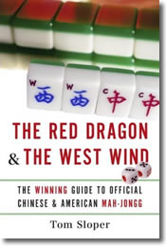
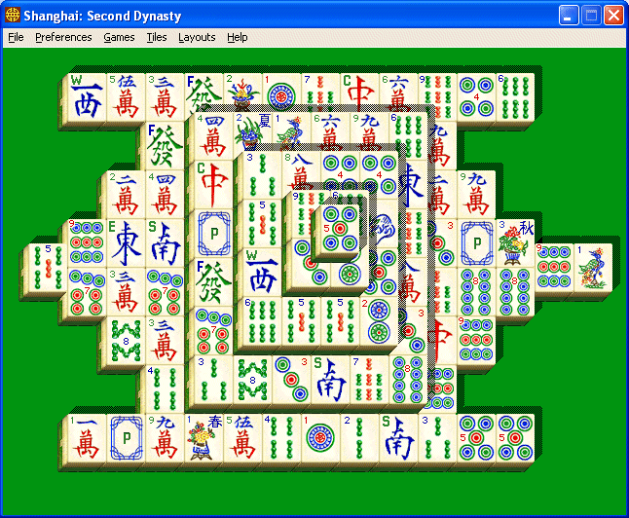
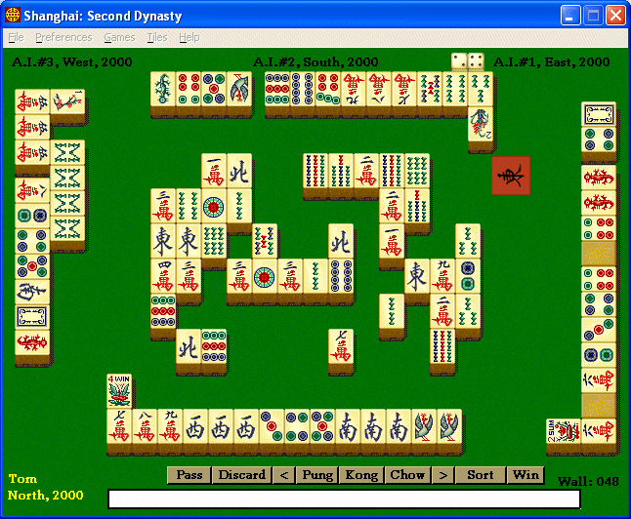
Tom Sloper
Video game designer, producer since 1982
Activision producer, 1988-2000
Shanghai franchise for 9 years
Sloperama.com
International player
The Red Dragon & The West Wind
Today’s talk
Mah-Jongg’s origin
American mah-jongg
Some strategy tips

Slide 3
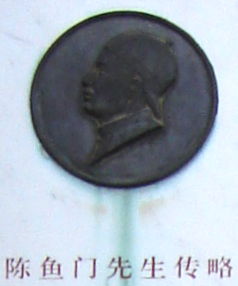
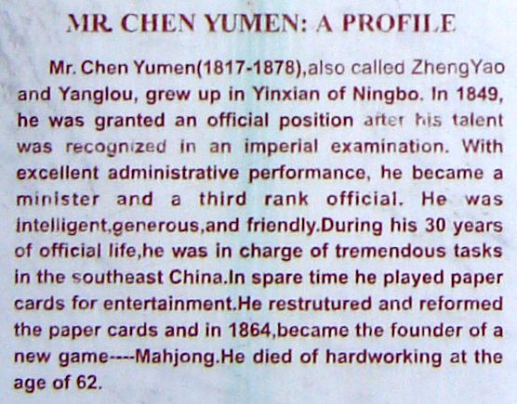
Mah-Jongg’s origin: 1864
Chen Yumen (1817-1878), Ningbo, China

Slide 4

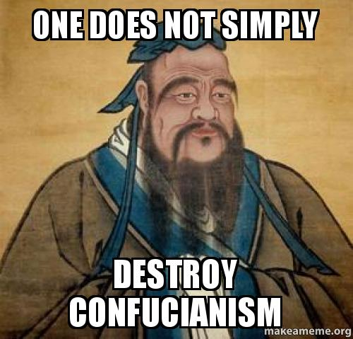
...but what about Confucius??
Kong Qiu, 551-479 BC

Slide 5
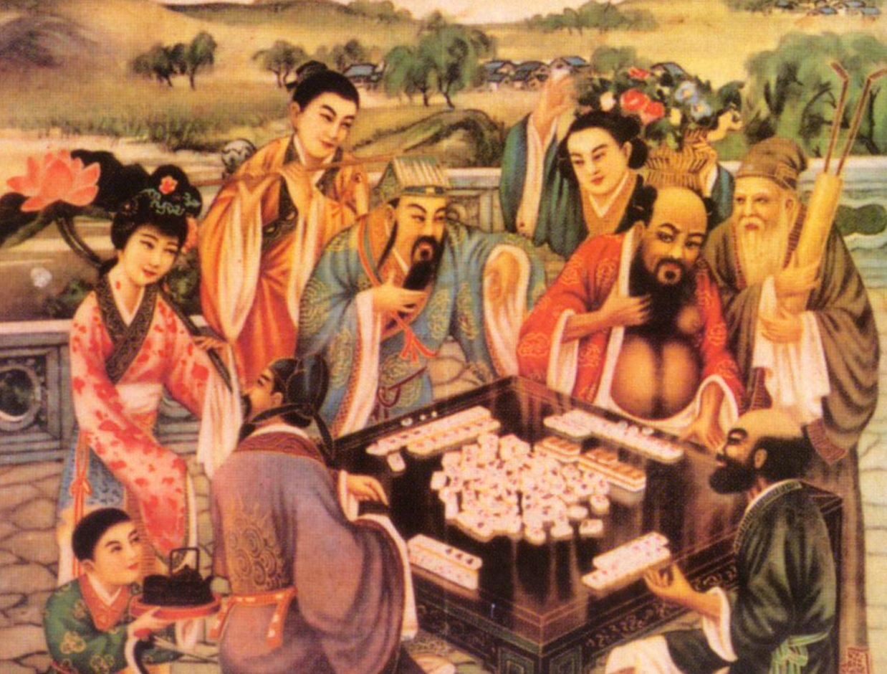

Two thousand six hundred years ago...

Slide 6
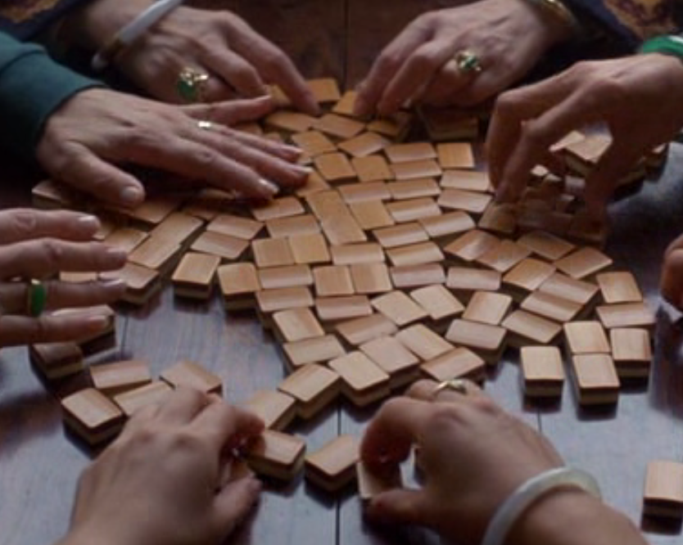
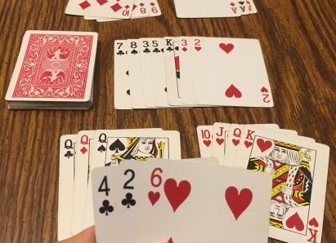
Mah-Jongg and Rummy
Similar gameplay
Draw and discard in turn
Form sets
First complete hand wins
Rummy originated in the mid-19th century in the Philippines or Mexico (nobody knows for sure)
Mah-jongg originated in 1864 in Ningbo
Nobody knows which game inspired the other, but card game historians are reasonably certain that’s what happened

Slide 7
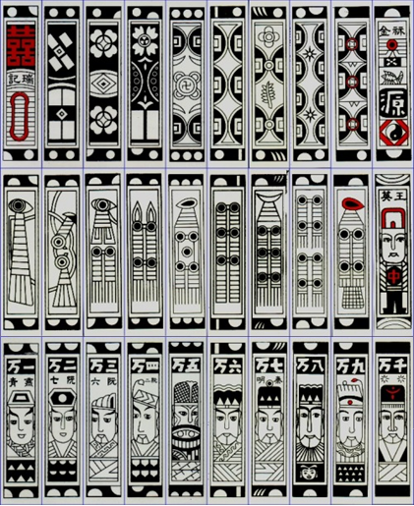
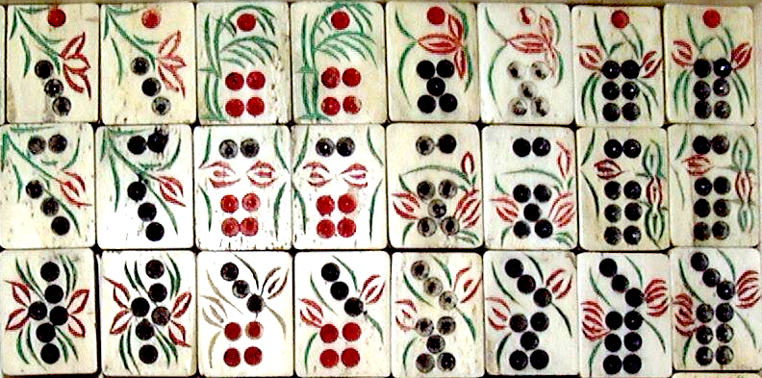
What Chen Yumen did:
He combined:
the suits of Madiao (a money-suited card game)
with the thick shape of dominoes
And he changed the gameplay of Madiao from trick-taking to set-forming

Slide 8
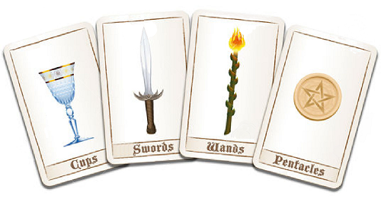
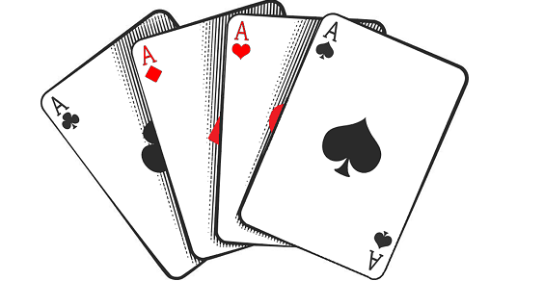
Money Suits Evolution
Marco Polo brought Madiao cards west to Persia and Europe
Coins, strings of coins, and myriads of coins evolved into pentacles, wands, cups, and swords (Tarot cards)
Pentacles, wands, cups, and swords evolved into diamonds, clubs, hearts, and spades (playing cards)

Slide 9
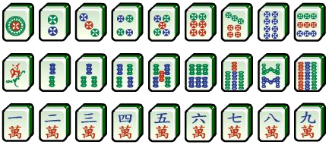
Money Suits Evolution
Chen Yumen changed Madiao’s complex images of coins, strings of coins, and myriads of coins into...
...the simple images we call dots, bams, and craks

Slide 10
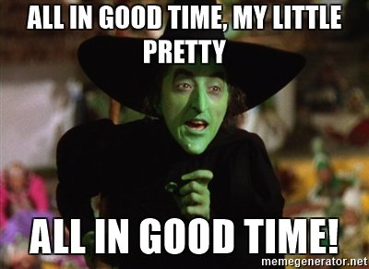
But what about the ladies who formed the National Mah Jongg League?

Slide 11
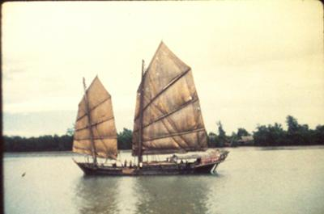
First, let’s talk about Joseph Park Babcock and the Roaring Twenties
A fateful river voyage
In the 1910s, junks needed wind to sail up river
When the wind stops, travel stops
And the boat crew brings out the mah-jongg tiles
Babcock spoke fluent Chinese and learned the game
“This would sell back in America,” he figured
And so...

Slide 12
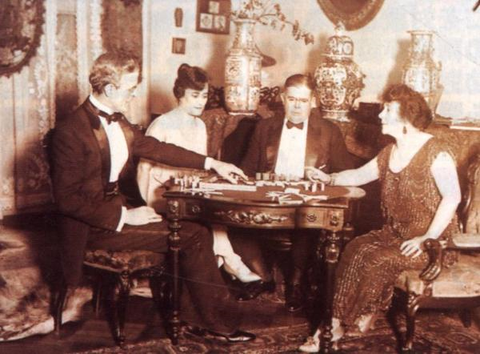
Babcock taught the game to potential partners, and got funding

Slide 13
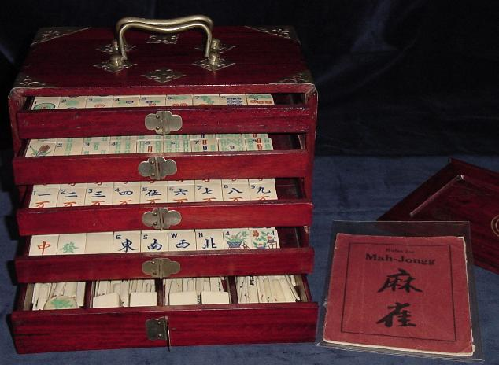
San Francisco, California
Lumber merchant W. A. Hammond imported and distributed Babcock’s sets as The Mah Jongg Sales Company of America.
Marketed in department stores alongside trendy Chinese clothing, accessories, and furniture
Game caught on big!
Soon after, Babcock licensed Mah-Jongg to Parker Brothers.

Slide 14
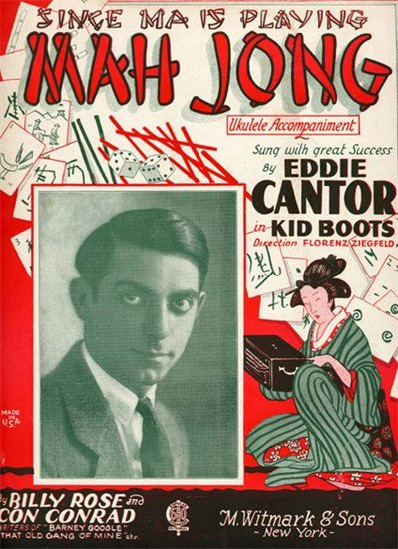

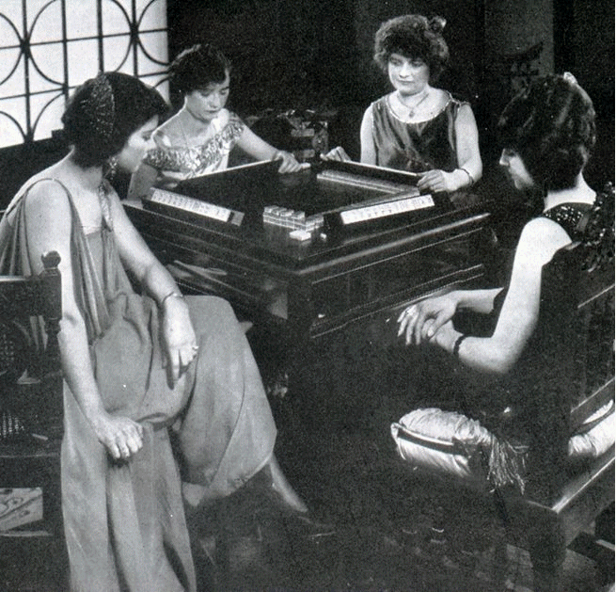
The Roaring Twenties - A Decade Of Fads -
World War I had just ended
Young women emerged from underdog status to become the trendsetters
Flappers
The Charleston
Phonograph Records
Movies
... and Mah-Jongg!

Slide 15
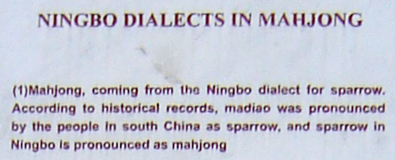
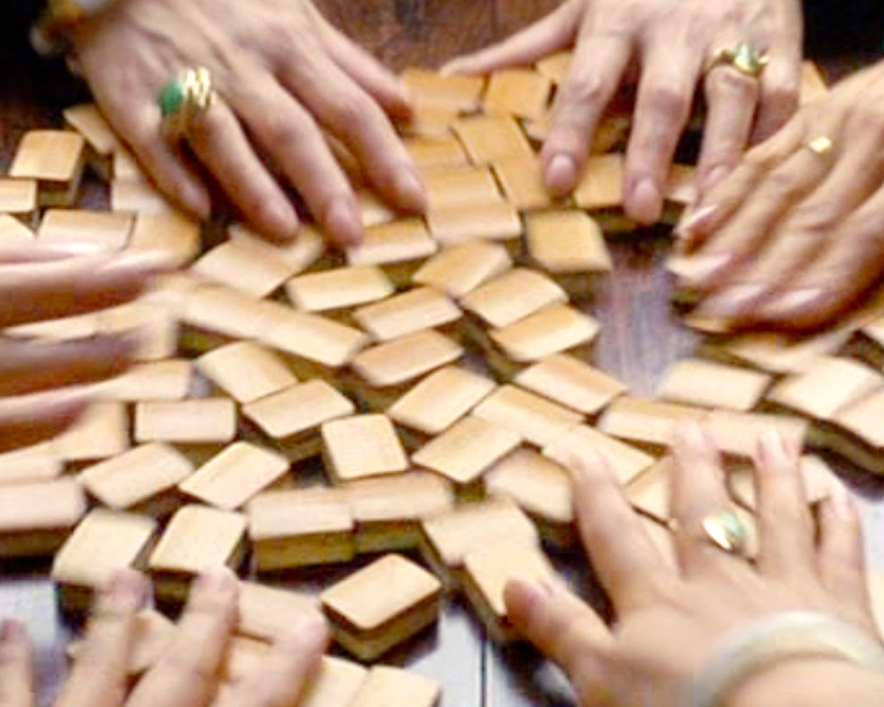
The Name Of The Game
Dialectical differences – mah cheuk (mah que), mahjong.
“Mahjong” means “hemp-colored bird.”
More colorful reading: “clattering sparrow.”
When bone-and-bamboo tiles are shuffled, they sound like sparrows squabbling over scattered bread crumbs

Slide 16
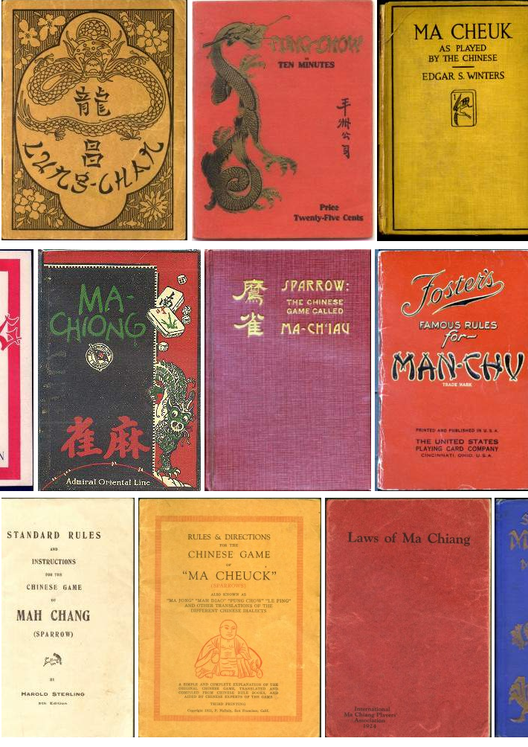
The Name of the Game (cont’d.)
Babcock trademarked “Mah-Jongg” (with hyphen and double G).
Other authors couldn’t use that trademarked name. Thus ensued a plethora of other names and spellings...
Mahjong
Ma Chiang
Mah Cheuk
Mah Deuk
Pung Chow
Pe-Ling
Lung Chan
Bird of a Thousand Intelligences
Which made for a lot of confusion

Slide 17
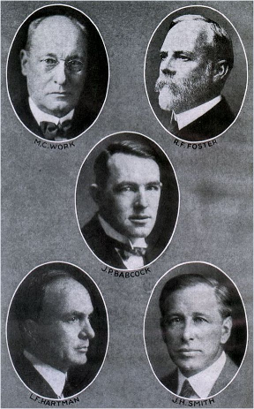
Men Wage The “Mah-Jongg Wars”
Babcock’s rules had been simplified for the American market
Other authors researched the real Chinese rules and wrote books
Experienced players hated playing with new players
Authors tried coming up with rules to satisfy everybody – and satisfied nobody
The Mixed Hand game
The One Double game
The Cleared Hand game
Standardized Laws
Too little, too late
The fad died in less than 4 years
The Standardization Committee of the American Official Laws of Mah-Jongg (1924)

Slide 18
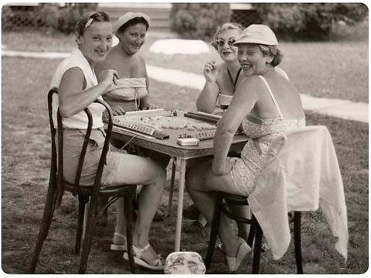
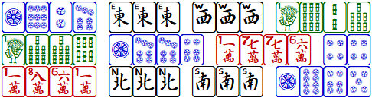
- The 1930s - The Ladies Take Over
Men had messed up the game
Women wanted to continue playing with the pretty tiles
But the Chinese rules were too complicated; chows made the game too “mathematical”
Women made their own rules and hands
Created interesting new patterns made of groups of similar tiles
Historical hands: Lucky Lindy, Independence, Civil War...
Flowers were “wild”
Problem: every neighborhood had different rules

Slide 19
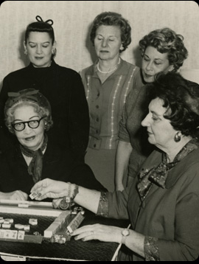
- The NMJL - Standardized Rules for American Mah-Jongg
Founded by Viola Cecil, Dorothy Meyerson, Hortense Potter, Herma Jacobs (1937)
Caught on like wildfire
Very popular in Jewish circles
The charity factor

Slide 20
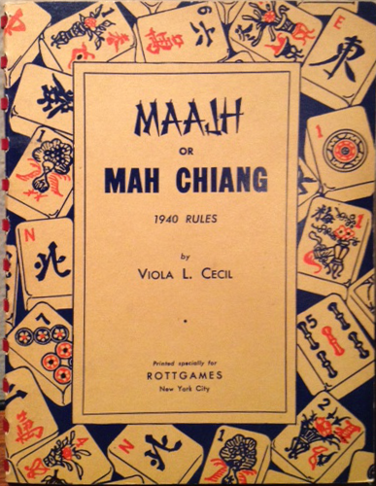
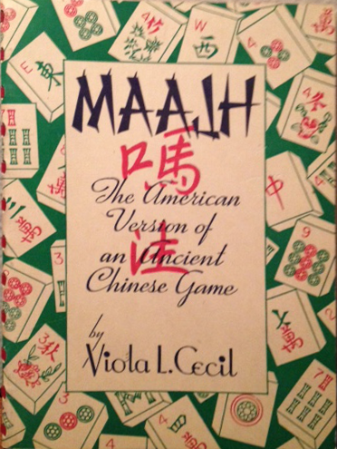
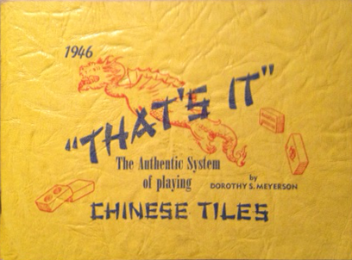
Early rulebooks

Slide 21
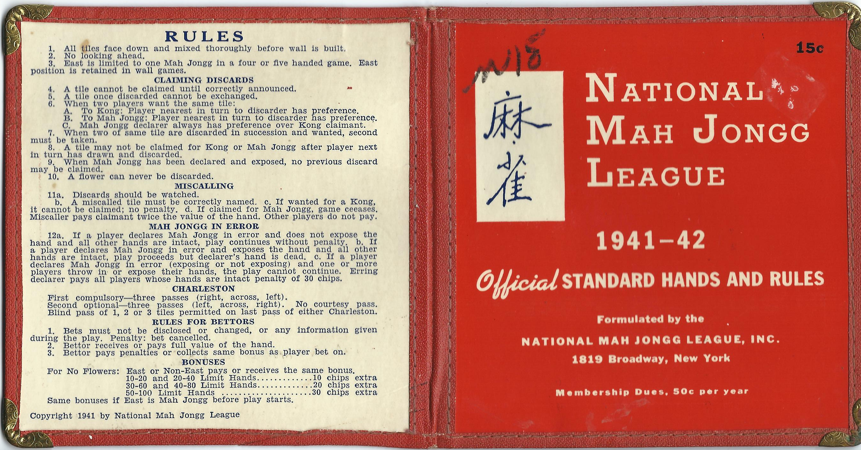
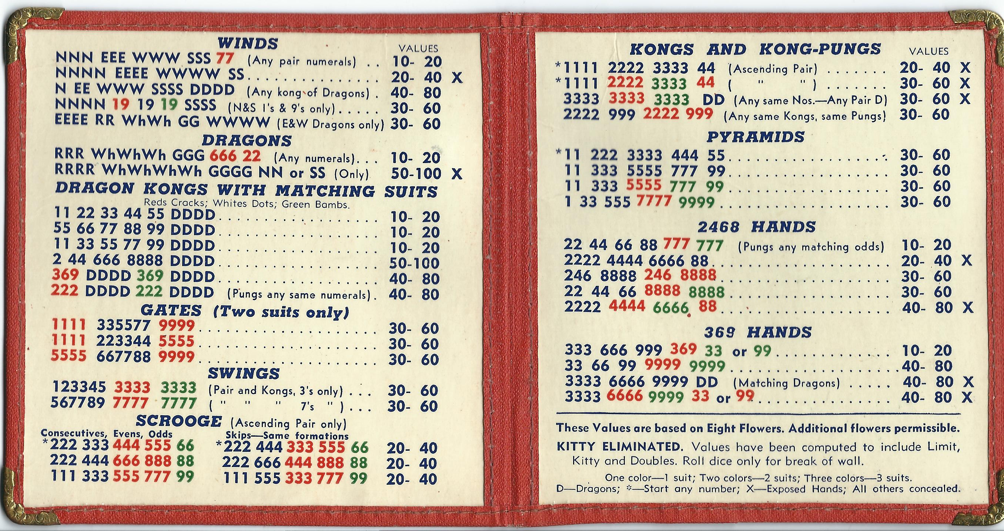
1940s – the rules were condensed down to a single card – price: 15 cents

Slide 22
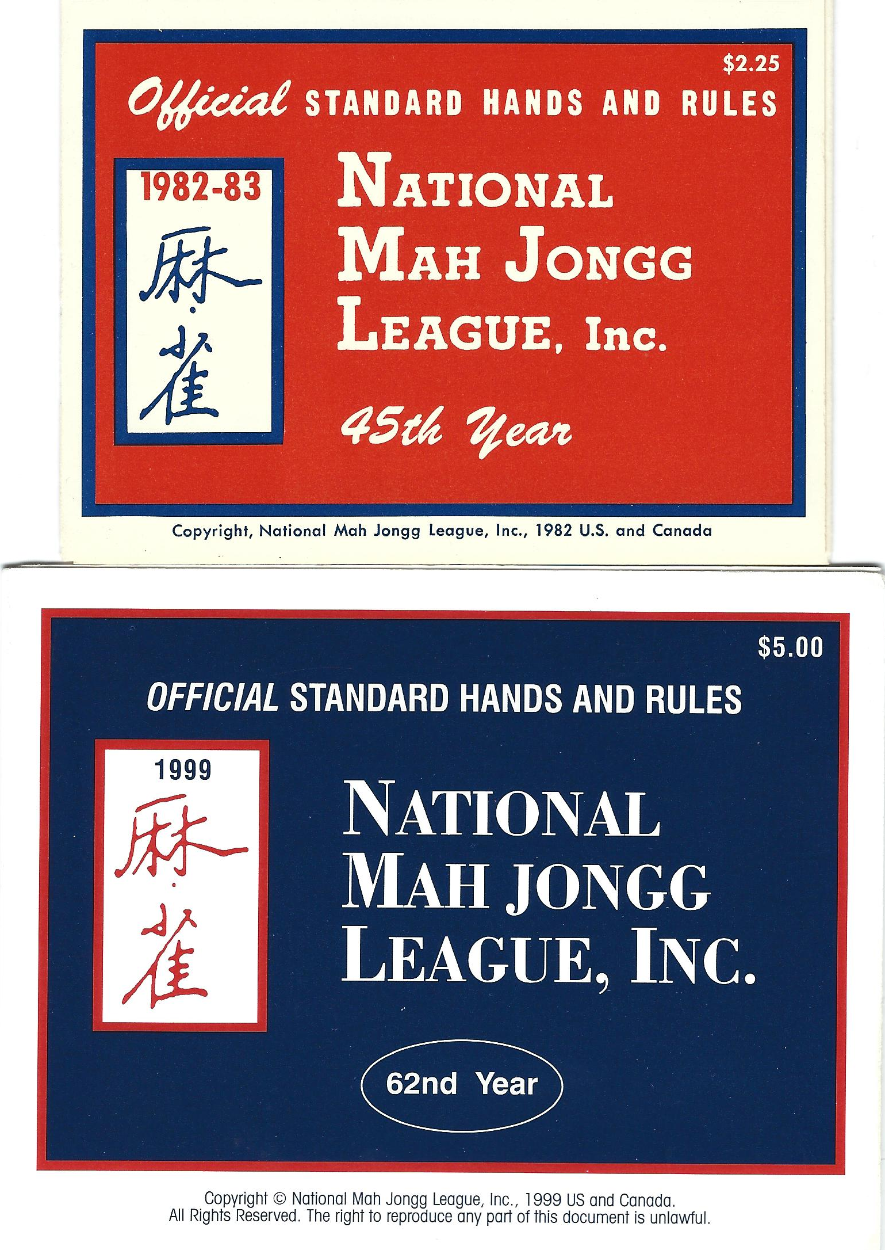
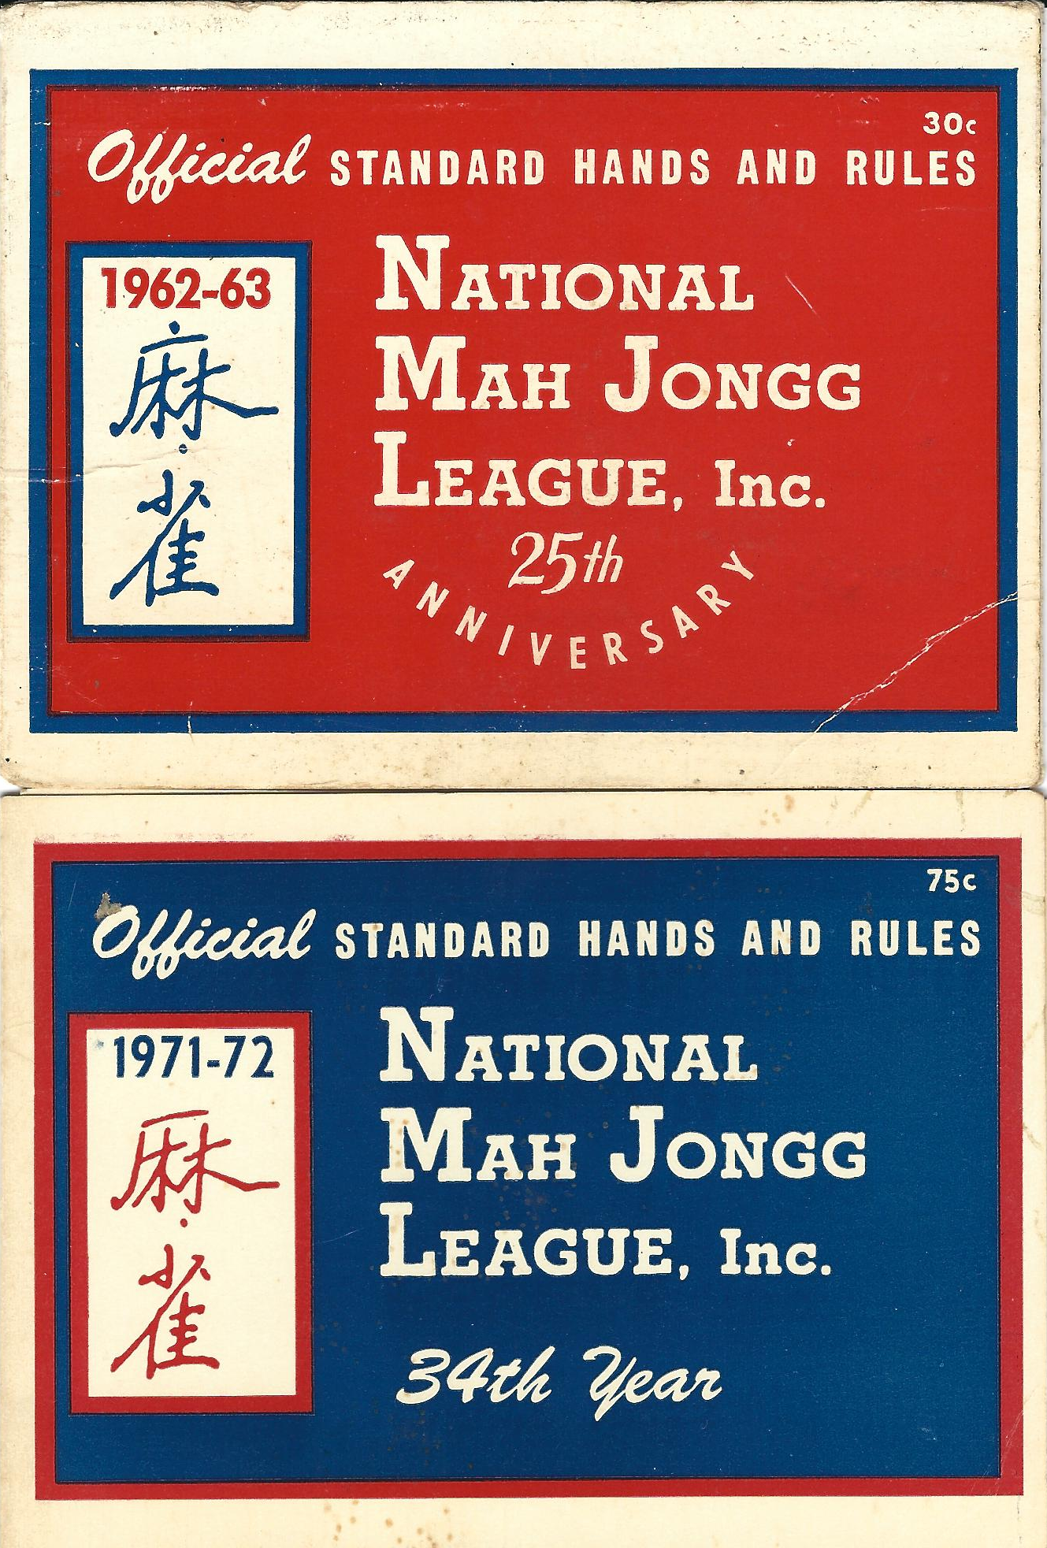
The price rose as the years went by...

Slide 23

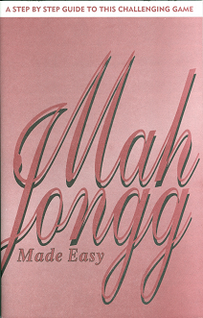
NMJL Timeline
1937: Viola Cecil was the League’s first president
1940: Hortense Potter became president
1942: Herma Jacobs became president
1956: “No looking or picking ahead” first appeared on the card
1961: jokers first appeared on the card
1967: Ruth Unger became president (would stay so for 48 years)
Late 1960s – younger players not picking up the game much
1971: the card stabilized at 8 flowers and 8 jokers
1984: “Mah Jongg Made Easy” first printed
Mid-1990s – sudden upsurge (because Internet)
2013: “Mah Jongg Made Easy” revised
2015: Larry Unger became president
2017: rumor – the rulebook being revised!

Slide 24
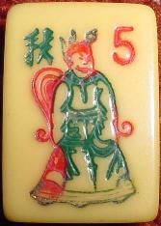
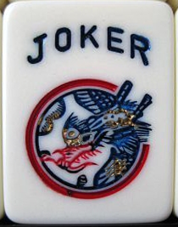
FLOWERS
8 flowers in 1937
Number of flowers increased, then fluctuated, until 1971
JOKERS
Flowers were the wild tiles until jokers came along
Jokers introduced in 1960-62 card
1937-1942 | 8F
1943 | 12F
1944-45 | 14F
1946 | 16F
1947-48 | 18F
1949 | 20F
1950-55 | 24F
1956-57 | 22F
1958-60 | 20F
1960-62 | 14F
1962-66 | 12F
1966-67 | 8F
1967-68 | 10F
1968-71 | 6F
1971-Present | 8F
1937-1942 | 0J
1943 | 0J
1944-45 | 0J
1946 | 0J
1947-48 | 0J
1949 | 0J
1950-55 | 0J
1956-57 | 0J
1958-60 | 0J
1960-62 | 2J
1962-66 | 4J
1966-67 | 6J
1967-68 | 6J
1968-71 | 8J
1971-Present | 8J

Slide 25



Slide 26
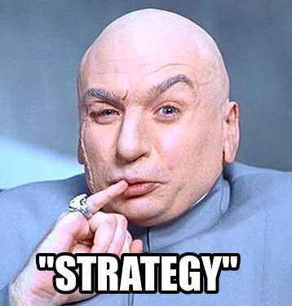
Okay. Let’s talk STRATEGY!
Sloper’s Charleston “Four Steps”
“The most powerful hand on the card”
“Joker bait”
Keep your eyes open!
“Poker face”
Luck
Harmony
Have a rulebook handy
My strategy column www.sloperama.com/mahjongg/
My Q&A bulletin board www.sloperama.com/mahjongg/

Slide 27
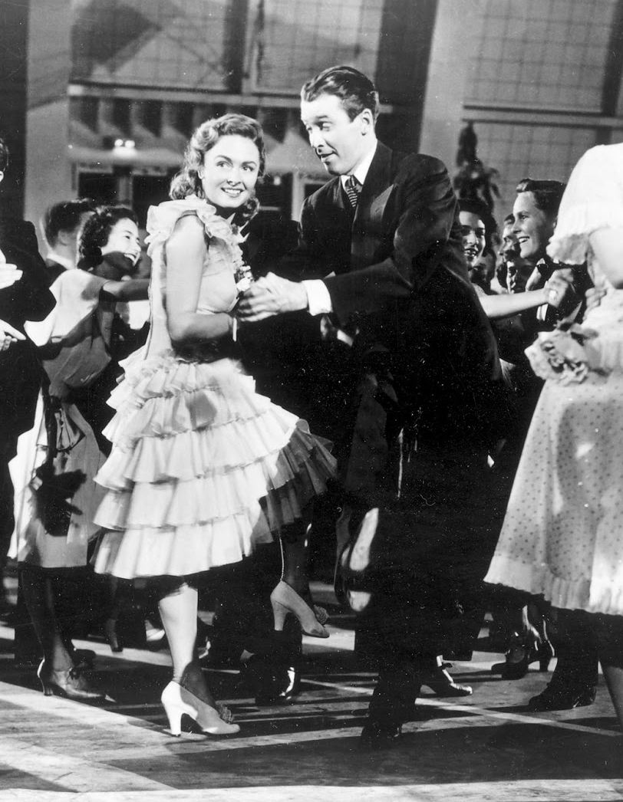
The CHARLESTON
It’s just a dance
You can’t always expect magic to happen
Keep it moving! Keep with the rhythm of the dance!
The Charleston is only about ELIMINATION
You’re just getting rid of tiles that don’t go together
You can’t win if you worry more about DEFENSE than OFFENSE
My “Four Steps” strategy...

Slide 28
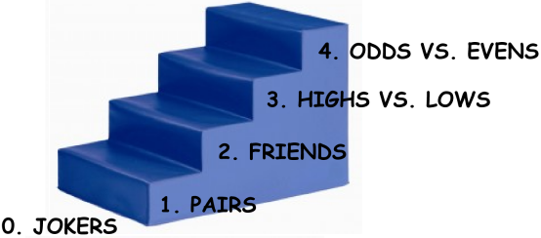
The Charleston: The Four Steps Strategy
0. How many JOKERS do you have?
1. How many PAIRS do you have?
2. Are your pairs FRIENDS with one another? Does your pair have friends?*
3. If no pairs, look at HIGHS vs. LOWS. Which do you have more of?
4. And lastly, look at how many ODDS you have versus how many EVENS you have.
* “Friends” are “tiles that work together for a hand on the card.”

Slide 29
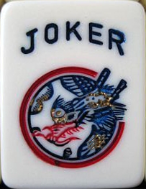
The Charleston: The Four Steps: Step 0
0. How many JOKERS do you have?
Do you have NO JOKERS?
Then don’t go for Quints!
Do consider Singles & Pairs
Do you have THREE OR MORE jokers?
Then consider Quints!
And don’t even THINK about S&P!
In fact, avoid hands with pairs (unless you already have the pairs)

Slide 30
The Charleston: The Four Steps: Step 1
1. How many PAIRS do you have?
Organize your tiles:
Put all the dots together, in numerical order.
Put all the bams together, in numerical order.
Put all the craks together, in numerical order.
Put your flowers at the left, your winds & dragons at the right
Put your jokers between your suit tiles and your winds & dragons
Count your pairs

Slide 31
The Charleston: The Four Steps: Step 2
2. Are your pairs FRIENDS with one another?
“Friends” are “tiles that work together for a hand on the card.”
If you have two or more pairs that work together for a hand, that tells you A LOT!
If you have just one pair, does that pair have friends?
If your pair has a bunch of friends, then that tells you A LOT!

Slide 32
The Charleston: The Four Steps: Steps 3 & 4
3. If you have no pairs, look at HIGHS vs. LOWS. Which do you have more of?
THE SUIT TILES ARE ¾ (75%) OF THE TILES IN THE SET.
THE CONSECUTIVE RUNS SECTION IS THE MOST POWERFUL SECTION OF THE CARD.
4. And look at ODDS versus EVENS. Which are more plentiful?
THE 13579 FAMILY IS THE 2ND MOST POWERFUL PART OF THE CARD.

Slide 33
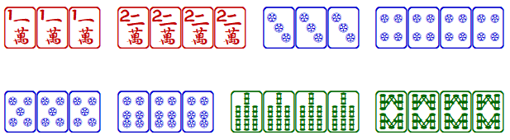
The most powerful hand on the card
The easiest hand on the card
The most flexible hand on the card
The most misleading hand on the card
Consecutive Runs #2
Only 4 numbers
Only 2 suits
No pairs (two pungs, two kongs)
On the card every year
Sometimes it might not be in the #2 spot
There is no shame in using it... in moderation.

Slide 34
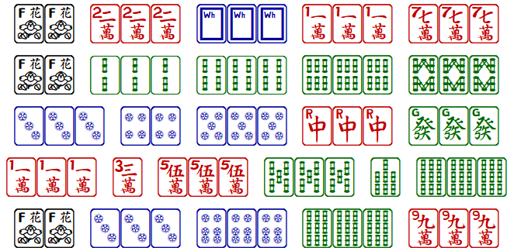
C? Easier than you think!
Does that blue “C” scare you off?
The bottom hand of many sections is a “four pungs and a pair” hand
Yes, they’re Concealed, but don’t let that stop you from trying for them
Despite the pair, “four pungs and a pair” is an EASY hand to make
That’s why they make those Concealed – to balance the challenge

Slide 35
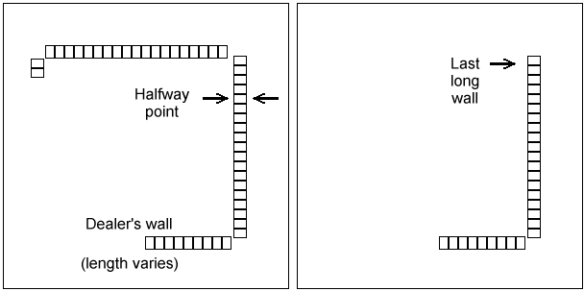
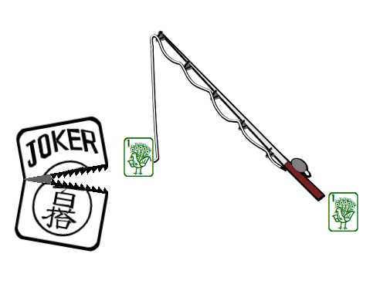
Joker Bait
Got a pair you can’t use?
Save it for joker bait if you can!
When you throw out the first tile of the pair, somebody might call it for exposure
Then on your next turn, you can redeem the other tile and get the joker
It doesn’t always work (especially flowers)
Timing is important: wait until after half the wall is gone (when the last long wall is in play)

Slide 36

Don’t play with blinders on
American mah-jongg uniquely requires players to name their discards out loud
Result: many players rely on only their HEARING for information on what’s going on in the game
You need to watch the table
Watch every discard
Watch every exposure
Look for dead tiles
Watch body language

Slide 37
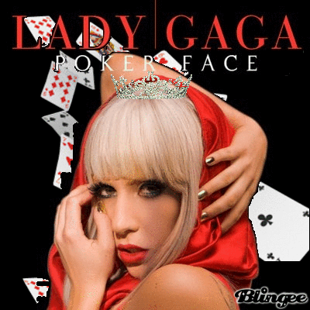
Poker Face
Many players broadcast what’s going on
“Who has all the jokers?”
“We didn’t shuffle the tiles enough!”
“Oy!”
Your body language can tell as much as your words
Change of attitude when picking a joker
Disgustedly discarding yet another unwanted pick
Finger on the card
Looking back and forth between another player’s rack and the card
Be cagey
Be inscrutable

Slide 38
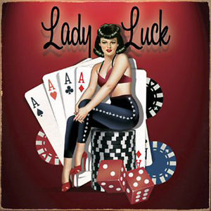
Luck
Mah-jongg balances luck and skill
If all players are equally skilled:
Each player will win 20% of the time ... over time
There’ll be a wall game 20% of the time ... over time
The skilled player, however, will win more often (over time)
Everybody has unlucky streaks
Lucky or unlucky, be a good sport so people will want to play with you

Slide 39

Harmony
Harmony is more important than winning. If all you care about is winning, nobody will want to play with you.
Good gamesmanship is about much more than just winning. It's about getting along, too.
If a conflict was ruled against you, accept it graciously and move on. (And no grousing about it later.)
Lose graciously ... and win graciously. Don't smug too much when you're on a roll.
Good sports also compliment others on good plays.
If playing with a newbie, help her learn so she'll get better (so she’ll be more fun to play with).
Don’t try to enforce etiquette. It only “annoys the pig.”

Slide 40

Table Rules
It’s normal for "table rules" to exist from table to table. Make any rule you like, so long as:
You all agree.
You are prepared to work out solutions when problems arise.
You are prepared to drop your special rule at other tables.
Know that it’s reasonable for any player at your table to assume that the official rules apply.
At your table, tell newcomers what the table rules are. Those folks will have to adapt. Be nice about it.
At someone else's table, ask what the table rules are. You will have to adapt. Be gracious about it.
Don’t ask what’s the “official” way to use a table rule. That’s an oxymoron!

Slide 41
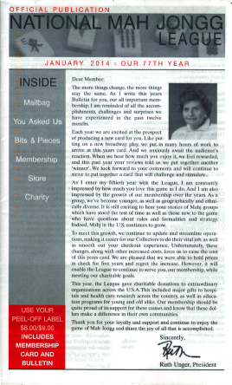
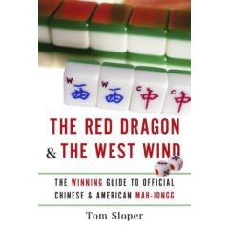
When something happens
Have the official rulebook at hand
It’s unfortunately not complete (rumor: it’s being revised, maybe)
Many rulings can be found in yearly newsletters (not in rulebook)
I compiled all those rulings in my book
Got iPad? You can check FAQ 19 at Sloperama.com/mahjongg/
No time for all that? Not sure what the real rule is?
Seek the smallest unfairness to the smallest number of players.
Determine who made the error.
The player who made the error is the one who should suffer its consequences.

Slide 42

The Internet is your friend
These slides are at Sloperama.com/downlode/
Frequently Asked Questions (FAQs) at Sloperama.com/mahjongg/
Q&A Bulletin Board at Sloperama.com/mahjongg/
“Weekly” [sic] strategy column at Sloperama.com/mahjongg/
Errata for my book at Sloperama.com/mahjongg/

Slide 43
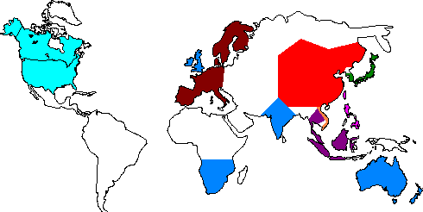
Today Mah-Jongg is played in many countries in many ways

Slide 44

The Mah-Jongg Family Tree

Slide 45
Where I’ve played
USA
ATLANTIC OCEAN
JAPAN
NETHERLANDS
DENMARK
INDIA
CHINA:
HONG KONG
HAINAN
TIANJIN
BEIJING
CHENGDU

Slide 46

Jokers
American-style jokers
Chinese-style jokers (“100 uses”)
Vietnamese-style jokers.
Red: Emperor, Bams Joker, Craks Joker, Dots Joker.
Blue: Winds Joker, Dragons Joker, Big Flower, General.

Slide 47

Japanese riichi/dora majan
Does not use flowers
No jokers, but red fives
High-stakes gambling game
Lots of things double the score
I learned it from video games and from Little Tokyo gamblers
Just 2 weeks ago: first World Riichi Championship was held in Las Vegas
224 competitors from Japan, America, Europe
Of course a Japanese man took the prize

