Slide 1

Augmented Reality vs. Virtual Reality
Tom Sloper
tom@sloperama.com
Nov. 9, 2016

Slide 2








C.V.
Game designer since 1982: Western Technologies 1979-83, Sega, 1984
Producer since 1986: Atari Corp., 1986-87; Activision 1988-2000
Awards: Mechwarrior SNES, Shanghai II: Dragon’s Eye SNES, Blast Chamber PS1, Shanghai: Great Moments PC/Mac
Game consulting, expert testimony - since 2001
Speaker: GDC, CGE, KGC, Siggraph, E4All, Smithsonian
Author, contributing writer: game industry books, mah-jongg books/magazines
Monthly IGDA column, 2002-2013
Faculty, USC Viterbi School of Engineering, since 2006
Enough about me.

Slide 3


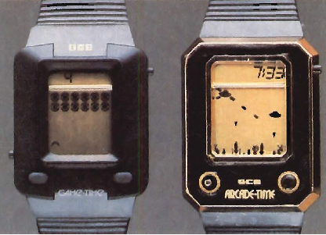
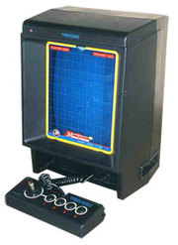






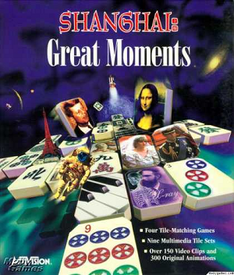





Slide 4
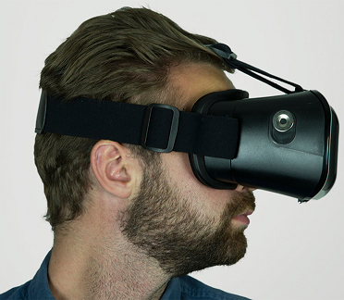
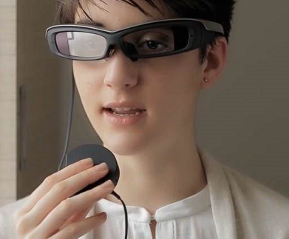
V.R. vs. A.R.
Sony
SmartEyeglass
Goji
Virtual Reality
  Replaces your view of the actual world with a view into a virtual world
  Nausea problem
  Physical movement in the actual world is limited;
  You go where it is
  Very sexy – everybody’s all a-twitter* over V.R.
*Note: few, by contrast, are all “a-facebook” over A.R.
Augmented Reality
  Augments your view of the actual world with additional content
  No nausea problem**
  Completely mobile;
  It goes where you go
  Was the embarrassing ugly cousin of the *.R. family... until Pokémon Go
**Just death by vehicle, death by falling, death by cop...

Slide 5
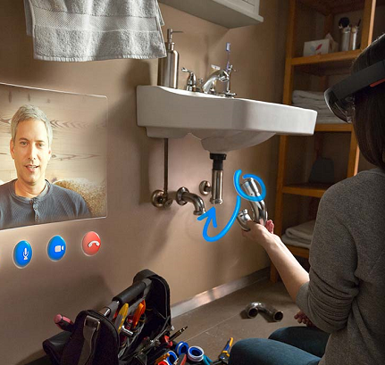
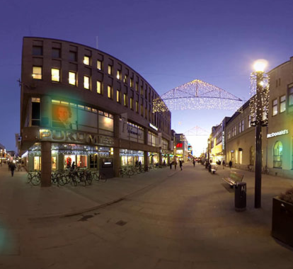
M.R. vs.
360° Video
From TheFoundry.co.uk:
Mixed Reality is an overlay of synthetic content on the real world that is anchored to and interacts with the real world...
...picture surgeons overlaying virtual ultrasound images on their patient while performing an operation, for example.
The key characteristic of MR is that the synthetic content and the real-world content are able to react to each other in real time.
Microsoft’s HoloLens... is set to be big in MR—although Microsoft have dodged the AR/MR debate by introducing yet another term: “holographic computing”.
- For our purposes, let’s lump this under AR
From Wikipedia:
360-degree videos, also known as immersive videos or spherical videos, are video recordings where a view in every direction is recorded at the same time, shot using an omnidirectional camera or a collection of cameras.
During playback the viewer has control of the viewing direction like a panorama, a form of virtual reality.
- For our purposes, let’s lump this under VR

Slide 6

VR not just for games
Hollywood investments in VR
VR Journalism: The New Way of Storytelling
United Nations Virtual Reality initiative, turning VR into a tool for social change
Cedars Sinai: Applied VR for pain reduction, anxiety reduction

Slide 7
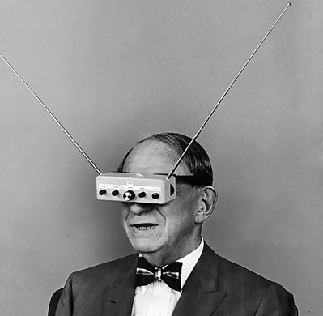
But I’m not here to talk about VR
I’ve been talking about AR since 2009.
I think AR is going to be more widely accessible than VR.
That doesn’t mean AR will replace VR; they’ll coexist.
They serve different purposes, and suit different audiences.
I’m most interested in wearable AR.
For playing games.
Anywhere.

Slide 8

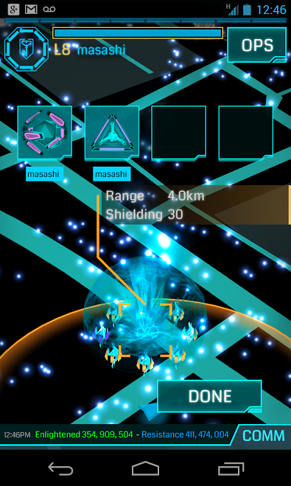
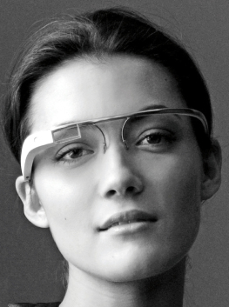
Highlights from the AR timeline
Nintendo 3DS AR Games, 2011
Ingress, 2012
Valve “terminator vision,” 2012
Disney Infinity, 2013*
Google Glass, 2014
Epson Moverio, 2014
Live Game Board, 2014
Father.io, 2016
Pokémon Go, 2016
Magic Leap and Lucasfilm, 2016
Sony SmartEyeglass, 2016
HoloLens, 2016
Snap Inc. Spectacles, 2016*
*(stretching the definition of A.R. too far)

Slide 9


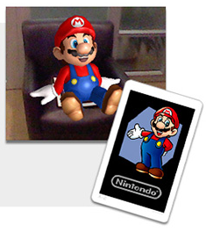


Nintendo 3DS
Uses the 3DS camera to view/display real world
AR card is scanned by 3DS camera from 14”
Then Mario is in your room, or Bravely Default’s fairy Airy flits around your room
Also Link, Kirby... Several 3DS games use AR card feature

Slide 10

Ingress
GPS game for Android/iOS by Niantic
Places game items and locations in the real world near you
Social aspects – players can team up with a few others to achieve game goals. A few times each year, large numbers of players can join up to fight large battles
Niantic learned a lot that they could apply to their next game

Slide 11
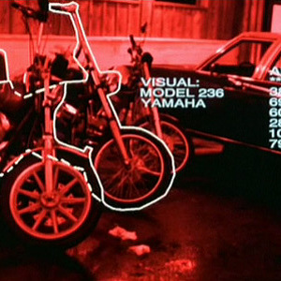
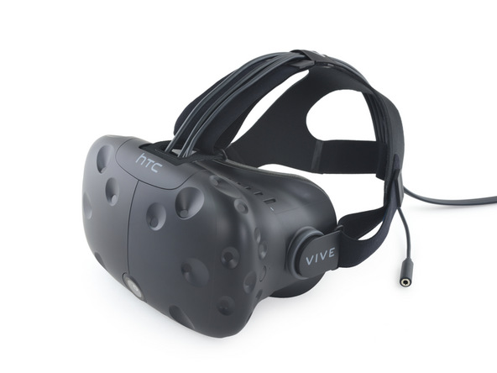
Valve “terminator vision”
Sounded promising... at first
Turned out to be an R&D concept, not a product
Eventually became the HTC Vive (a VR headset)
http://blogs.valvesoftware.com/abrash/valve-how-i-got-here-what-its-like-and-what-im-doing-2/

Slide 12
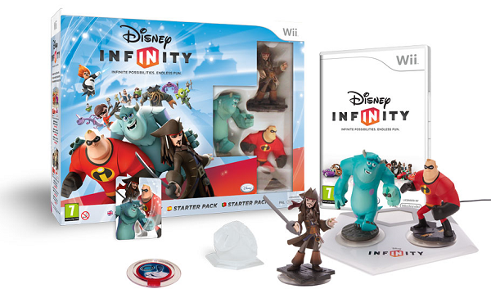

Slide 13

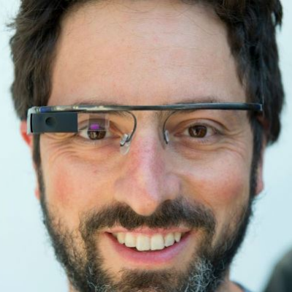


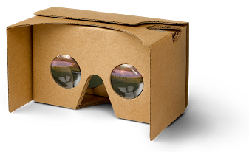
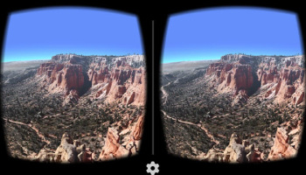
Google Glass
Sounded promising... at first
Had limited applications
Looked geeky
Quietly discontinued
Google Cardboard worth mentioning, but that’s VR, not AR

Slide 14
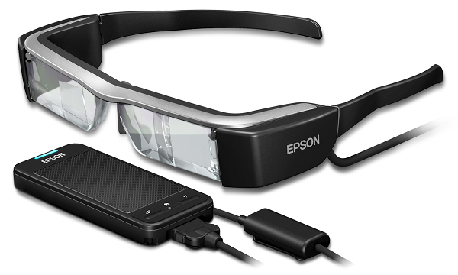
Epson Moverio
AR glasses from Seiko Epson Corp., セイコーエプソン株式会社, maker of printers (“Epson” = “Son of Electronic Printer”) and imaging equipment

Slide 15





Slide 16
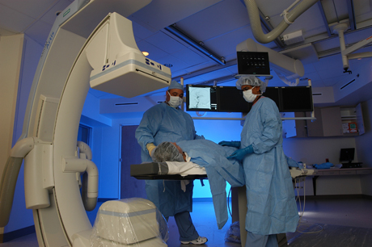
HTE’s “IR Goggles” Idea
Health, Technology, and Engineering (USC)
Interventional Radiology
Met the doctors
Gathered list of requirements
Went online, did research (November-December 2013)

Slide 17

The need

Slide 18
Features
Required
Desired
Streaming video (15fps or better)
Transparent
Lead shielded
Wearable with glasses
Voice command
Eye tracking
Binocular
3D
Lightweight

Slide 19
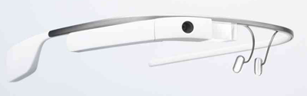
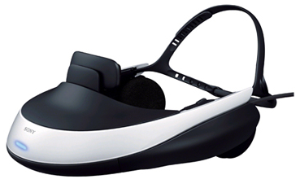
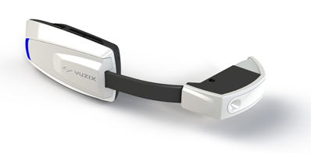
Variety of wearable devices (2013)
Google Glass
Sony HMZ-T1
Oculus Rift
Epson Moverio BT-100
Vuzix M100
Microsoft (unnamed)
CastAR
Oakley Airwave
Zeal Optics Transcend

Slide 20
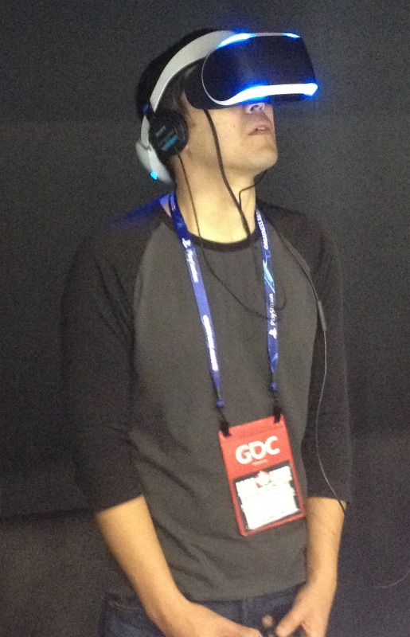
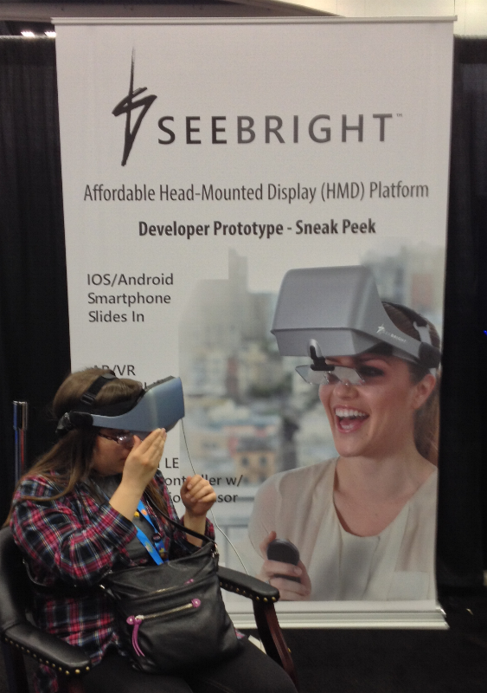
Meanwhile, at GDC 2013
Sony’s MORPHEUS
SEEBRIGHT

Slide 21
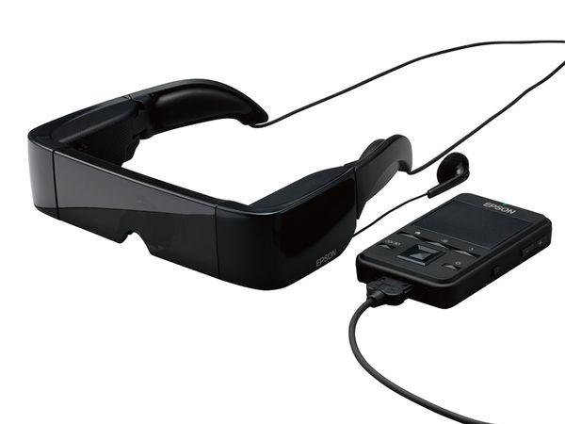
Epson’s Moverio BT-100
Pros:
  Supports streaming video via Wi-Fi
  Transparent (can see real world through display)
  Fits over glasses
  Binocular
  Free SDK
  Epson’s US office is in Long Beach
Cons:
  No voice-control
  Heavy
  Limited availability

Slide 22

Seeing Is Believing
After Christmas break and CES were out of the way, we went to see the BT-200 in person
Yes, I said 200 (not 100)
Newer, lighter, even better for our needs
Pronounced highly suitable

Slide 23
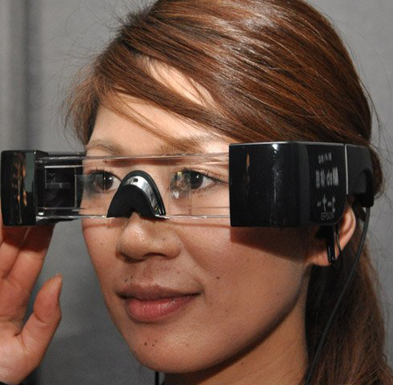
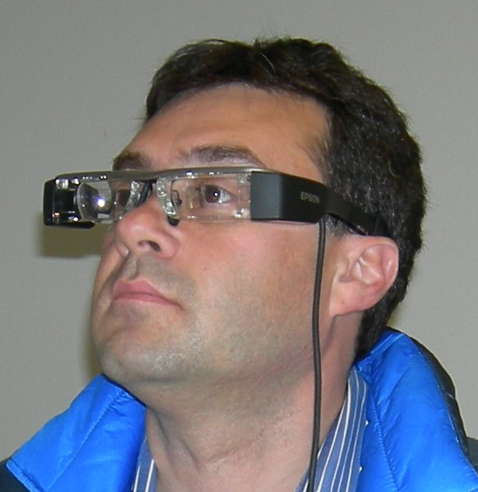
The old – the new
BT-100
BT-200

Slide 24


Close, but...
The device was an Epson R&D experiment, not yet a fully supported commercial product
We couldn’t get video streaming to work
HoloLens and Sony SmartEyeglass have probably overcome that; I need to check back in with HTE

Slide 25



Slide 26
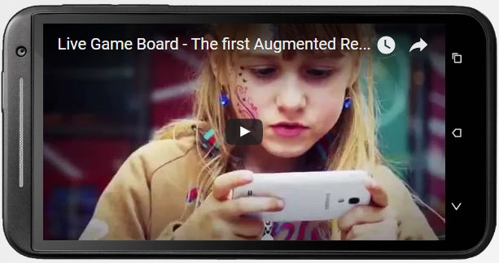
LiveGameBoard.com: Live Game Board is... “a mat which acts as game board on which 3D virtual content is layed over.”
Multiple games, more in the works
Supports Android at present

Slide 27
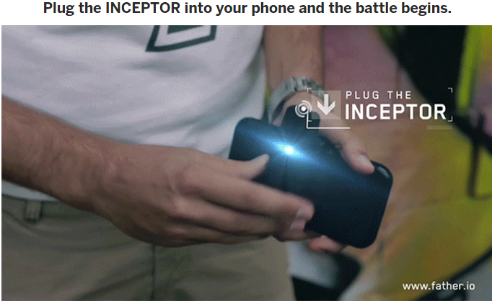
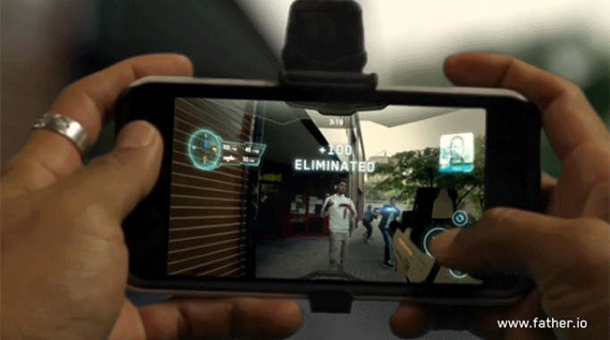
father.io
Real-life, massive multiplayer, first person shooter – think massive multiplayer laser tag
Crowdfunded on indiegogo, April 2016

Slide 28

Pokémon Go, July 2016
Niantic, GPS-based
My students beta-tested
I downloaded it but my 16GB iPhone 4S crashed
So I got a 64GB iPhone SE
At first, I wasn’t sure if the game was really AR
But we soon heard about situations I’d foreseen for wearable AR games

Slide 29


Pokémon Go incidents
Melbourne: player killed by hit-and-run driver
Las Vegas: player mugged
Rio: Olympic gymnast racks up $5,000 phone bill playing PG
Ohio: two players arrested for trespassing in a zoo
Brooklyn: player falls into pool
Encinitas: two players fall off cliff
Tampa: player refuses cop’s order to vacate park, gets tased
Saudi Arabia: Pokémon outlawed
UK: playing banned in cemetery
Missouri: robbers lure players with a planted Pokéstop
Baltimore: player crashes into cop car
Tokyo: man assaults player, accusing her of photographing him
Long Island: idiot hurt, playing while skateboarding
Toronto: homeowner fires pellet gun at pesky plethora of players
San Diego: players chase Pokémon, find dead body

Slide 30


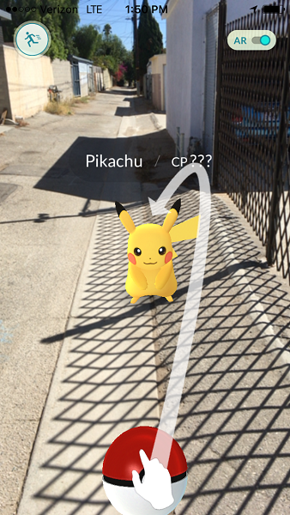
Doubts dispelled – it is AR

Slide 31
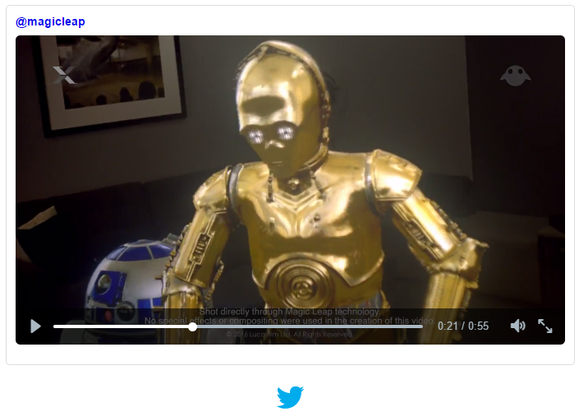
Magic Leap / LucasArts, 2016
R2D2 and C3PO in your livingroom
https://amp.twimg.com/v/b011d12a-128c-41f5-9a25-eddf7e4616be

Slide 32

HoloLens
(Project Baraboo)
“The hololens FOV is... equivalent to holding an 8.5x11 inch sheet of paper 18 inches... from your face...
The surprising bit about the hololens (which I'd never considered) is that because it's a hologram, the color "black" is transparent, so if you're a keen observer of both the hololens and magic leap videos, you'll notice that they very carefully design their scene objects to not have black or dark colors. It's an interesting design limitation, but by no means does it detract from the coolness of the hardware.”
So sayeth slayemin - http://www.gamedev.net/topic/679414-magicleap-teams-up-with-lucasarts/#entry5312935

Slide 33
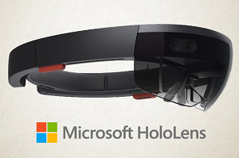
Amsterdam studio Capitola VR builds Pokémon Go mixed reality demo – 3D (not 2D) Pokémon in your room http://hothardware.com/news/developer-shows-pokemon-go-demo-for-microsoft-hololens
“Imagine playing... without having to hold up and stare at your phone the whole time.” http://www.forbes.com/sites/robsalkowitz/2016/07/13/why-pokemon-go-is-great-news-for-microsoft/

Slide 34
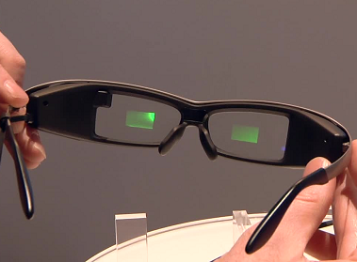
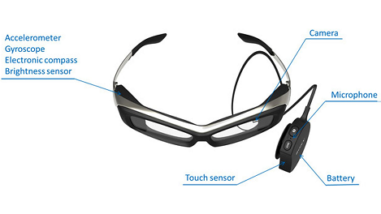
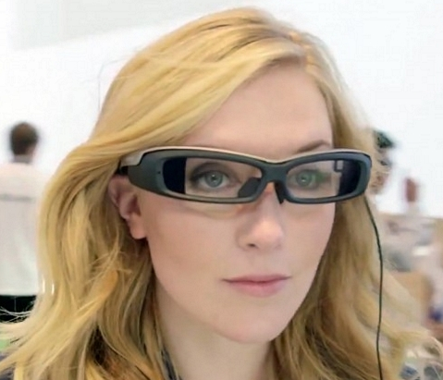
Sony SmartEyeglass
Viewscreens for both eyes
Not too heavy
Not too awkward looking
Suitable for games, but not its intended main feature

Slide 35
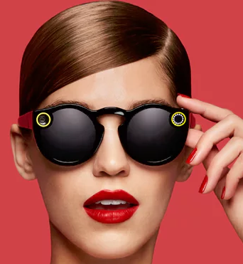
Snapchat Snap Inc. Spectacles
Video camera in the form of sunglasses
Uploads videos to Snapchat
Not an AR headset but a wearable camera
Nov. 8, 2016 – Spectacles to incorporate World Lenses feature, add MR visual filters, animated effects, to captured videos

Slide 36


My current project
Brittingham Social Enterprise Lab, MSSE program
Grad student team ideating an AR-based training game about sexual assault for college students
Title IX requires training for all students – usually via boring program for PC
Our vision: mobile phone GPS-based training with location-specific interactive scenarios

Slide 37



Slide 38

Wearable AR Games
More promising than wearable VR because:
  More accessible
  More affordable
  Play anywhere
  Move safely
  Hands free
  No nausea!
Possible with current technology (and improving)

Slide 39
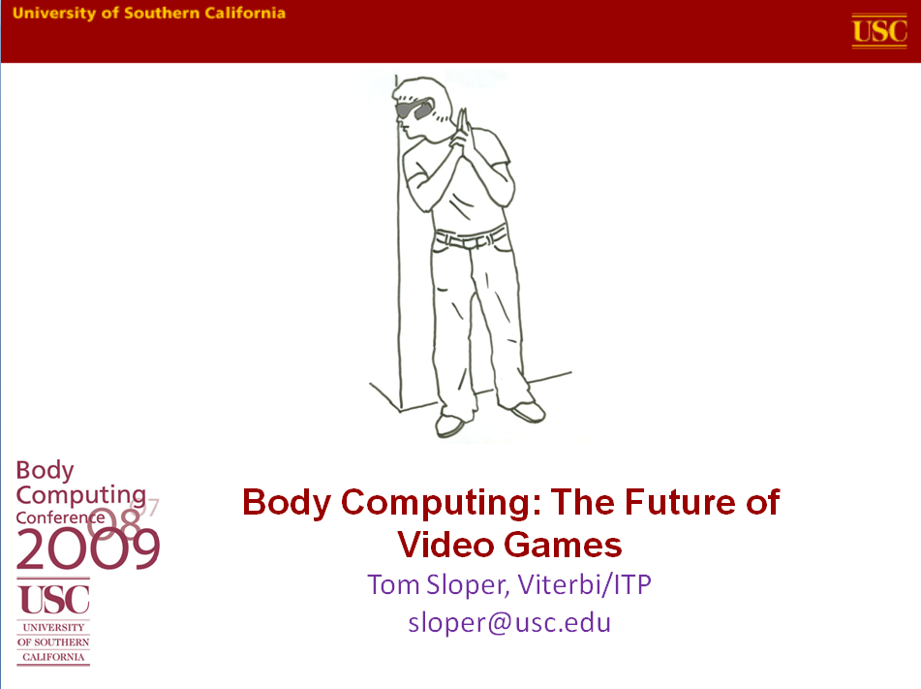

Slide 40

Future Salon LA
Microsoft Store
Westfield Century City
August 12, 2012
http://sloperama.com/downlode/FutureOfGames120812.pptx

Slide 41
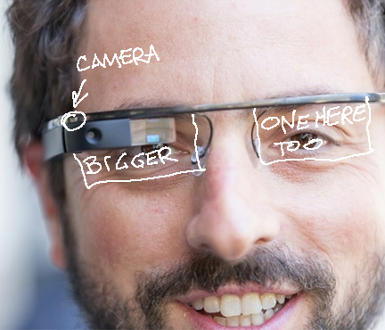
A mobile AR device – not a VR device tethered to a PC
A see-through HUD or HMD
Image: venturebeat.com
(modified)

Slide 42
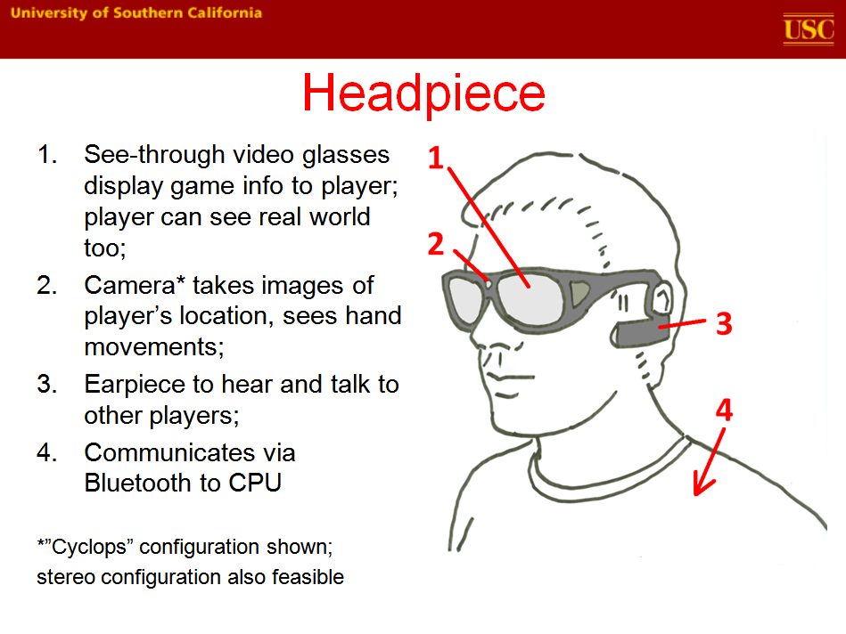

Slide 43
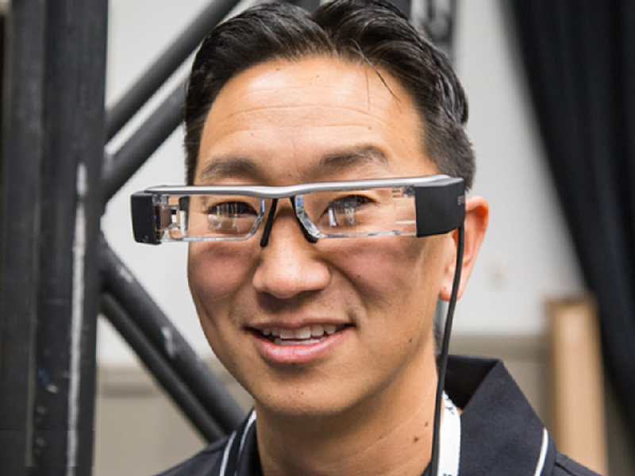
2014
2013

Slide 44
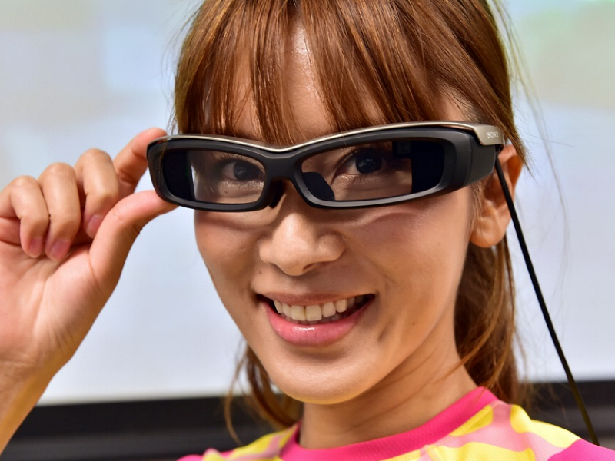
2016

Slide 45
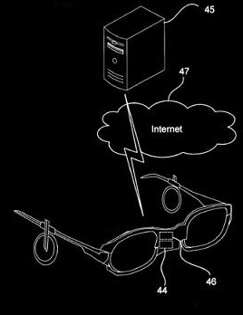
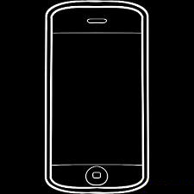
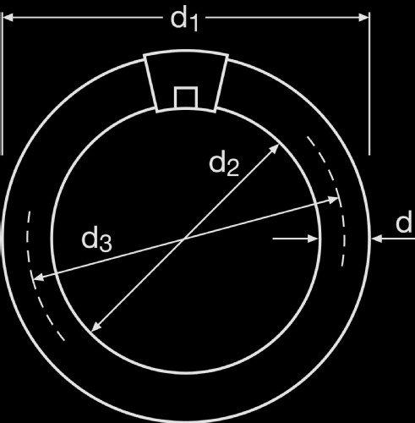
The cloud
The headset is just a display and receiver/transmitter, not a game machine per se
The game logic, collision detection, scoring, and all user inputs are calculated on a server in the cloud
Cloud connection: smartphone

Slide 46

GPS
Multi-player shooter – GPS knows location of your opponents (alien monsters, for example), in relation to your real world location
HUD can overlay alien monster image (for example) over the visible actual opponent
Can also show you an A.I. alien monster where no actual person exists
Image: Defenseindustrydaily.com

Slide 47

Wearable camera
Can see what the player sees
Can see player’s hand movements (when hand in camera’s field of view)
Can upload player’s view to the game in the cloud
Can give spectators, commentators, opponents a view of the game from player’s POV
http://andrewsullivan.thedailybeast.com/2012/06/the-future-of-seeing.html

Slide 48
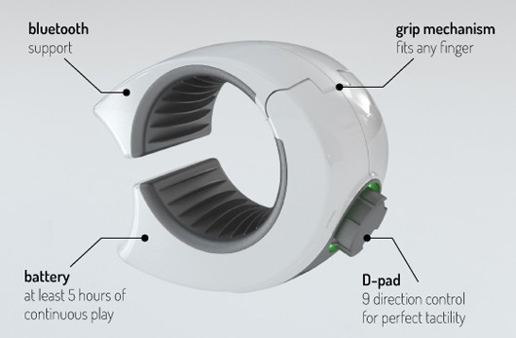
Bluetooth ring
Ring can include several micro sensors (e.g. accelerometer, gyroscope, magnetometer...)
Better input than can be obtained by camera view of hand
Swedish university, Ringbow (pictured)

Slide 49

No recycling this time
When mobile games first came on the scene, game designers harkened back to the simplicity of Atari 2600 and LCD games
But with AR glasses? Whole new ball game!
A whole new ball game

Slide 50
What kind of games can be played on it?
First-person shooters – multi-player or single
  Drawback: death by cop
Scavenger hunts, treasure hunts, dungeon crawls
  Drawback: arrest for trespassing
Map conquest à la Risk
  Drawback: actual global conquest
Parkour (free-running) planning
  Drawback: ambulance/hospital/funeral bills
Sliding block puzzles; draw pictures in the air; draw pictures on the Earth
  Drawback: look like a dork (so what else is new?)

Slide 51
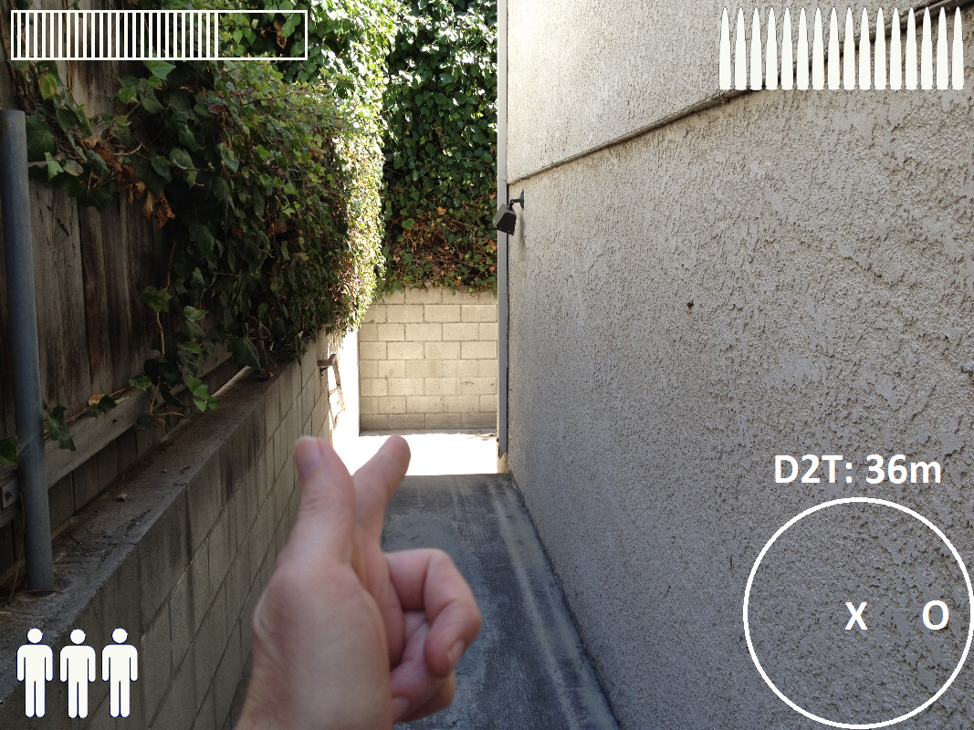
Alien Beast FPS

Slide 52
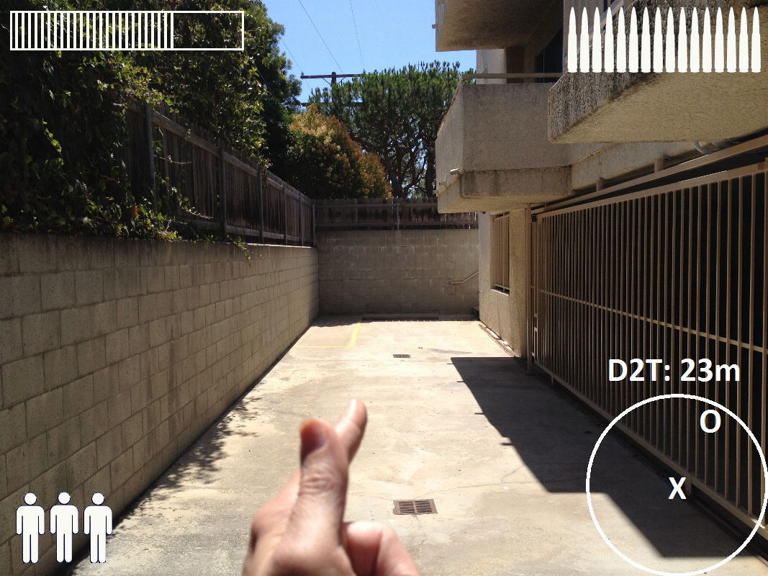
Alien Beast FPS

Slide 53
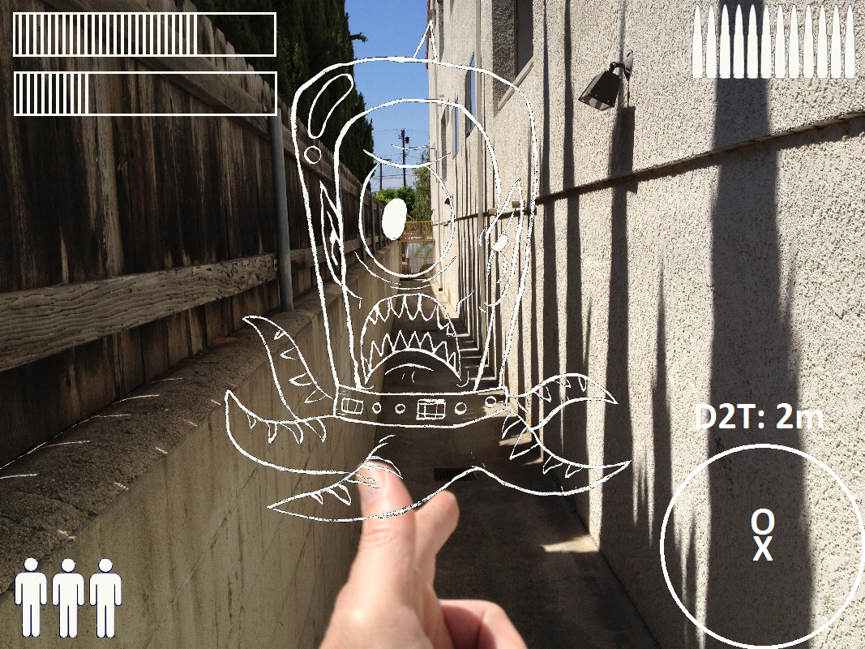
Alien Beast FPS

Slide 54

Unforeseeable consequences
You thought texting while walking was bad??
There will be laws!

Slide 55



How do you...
...warn players about real-world dangers? Cliffs, tall buildings, lions, tigers, bears
...make sure players don’t play in traffic?
...keep game from being played where games not appropriate? Airports, schools, malls, libraries, cemeteries, religious centers

Slide 56


Those questions validated
...and then some
August 2016 – California state Assembly altering laws against texting while driving to include games like Pokémon Go
Sept. 2016 - The journal JAMA Internal Medicine says the AR game plays a role in abt. 10,000 instances of distracted driving daily
July 2016 – fire stations and jails attract Pokémon Go players. Also: UC Irvine Medical Center, Arlington Nat’l Cemetery, Auschwitz-Birkenau State Museum, all swamped by players
Areas around registered sex offenders’ homes not blocked for underage Pokémon Go players
Data usage spikes, costs rise – and your data security at risk

Slide 57


Slide 58
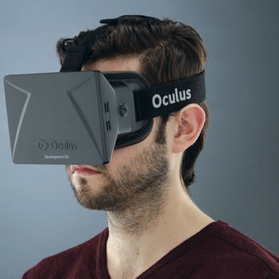

^{AR} over _{VR}
Virtual Reality
Augmented Reality
More expensive
Requires a computer...
...Or you have to go to a special facility to enjoy it
Requires you limit your movement, else hurt yourself bumping into things
Nausea
What if you wear prescription glasses?
Affordable for more people
Works with your existing smartphone
No special theater required
Go anywhere, but don’t play in roads, or cemeteries, or Saudi Arabia, or the front yards of shotgun owners
No nausea!
Has to be wearable over your prescription glasses

Slide 59


Is this “it”?
Will wearable AR games be the hotness of the next decade?
Nobody can predict the future. “He who believes he can predict is least likely to predict correctly” – Taleb, “The Black Swan”
What will be hot depends on who the player is,
How s/he wants to play,
And where.
Images: theclevermonkey.blogspot.com

Slide 60

We’re getting closer every day
We haven’t seen it yet
But it’s coming
It’s inevitable
And I’m looking forward to it!

Slide 61
Augmented Reality vs. Virtual Reality
Discussion
Tom Sloper
These slides: http://sloperama.com/downlode/
Contact: tom@sloperama.com
Devs discuss VR, AR: http://www.gamedev.net/forum/162-virtual-and-augmented-reality/

