Slide 1

HTE: Interventional Radiology Goggles

Slide 2


Slide 3
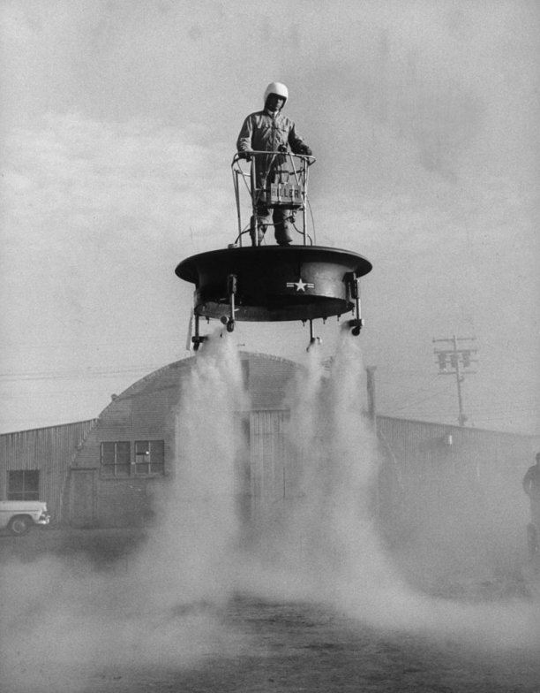
The Game Platform of the Future?

Slide 4


Slide 5

Future Salon LA
Microsoft Store
Westfield Century City
August 12, 2012
http://sloperama.com/downlode/FutureOfGames120812.pptx

Slide 6
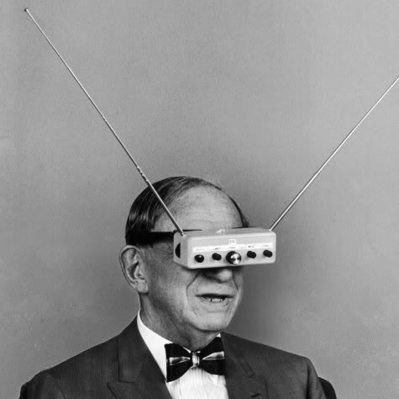
Augmented Reality (AR)
Wearable television was foreseen quite some time back
But this isn’t quite what I had in mind (it obscures the real world)
Image: tsutpen.blogspot.com

Slide 7
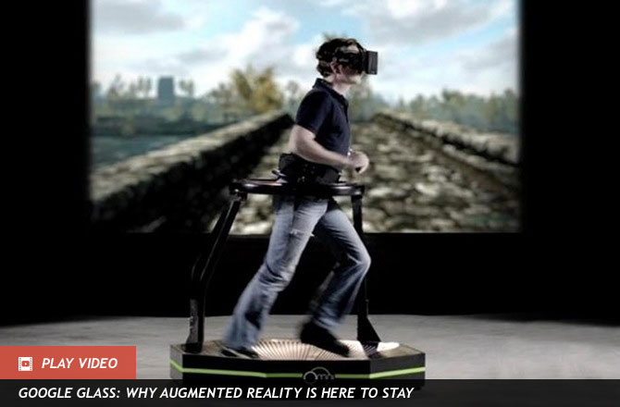
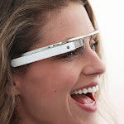
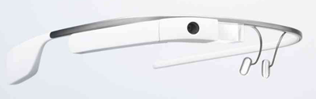
Wearable games: VR vs. AR
Virtual Reality
Oculus Rift
Virtuix’s Omni treadmill
Augmented Reality
Google’s “Project Glass”
Valve’s “Terminator Vision”

Slide 8
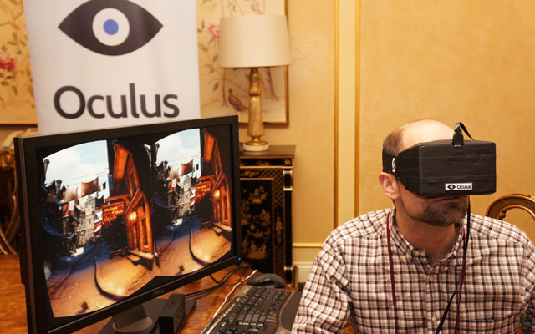

Slide 9
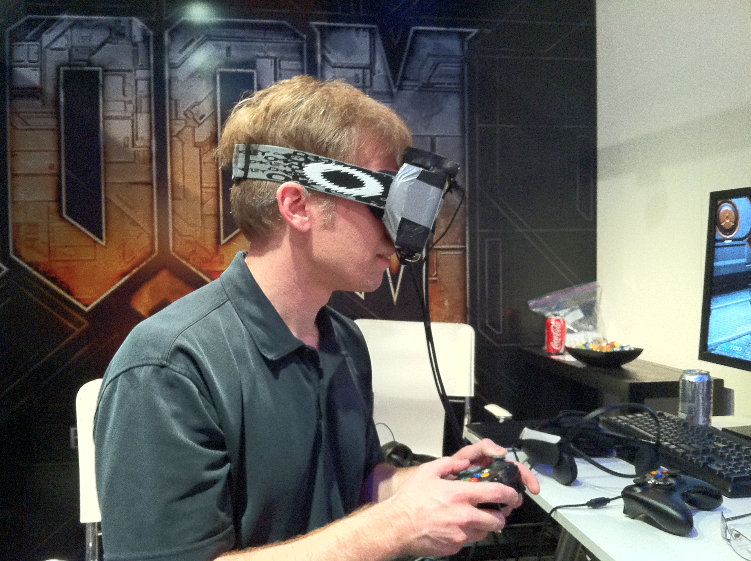
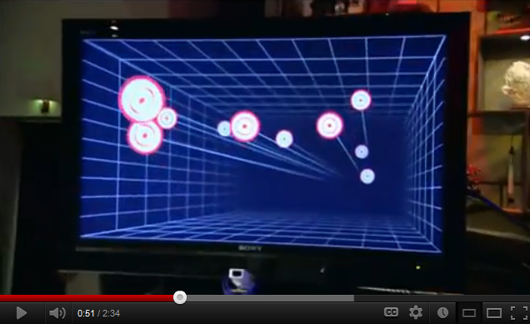
Oculus Rift (VR Ready: R U?)
L: John Carmack at E3 2012
R: What Head Tracking looks like (youtube)
It’s a nifty 3D viewer for your PC game
Images: gamesindustry.biz, youtube.com

Slide 10
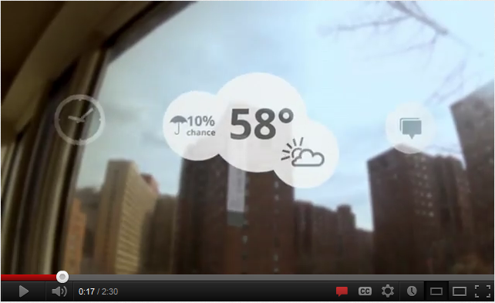
Wearable Computers (AR)
Google Glass
Monocular
See-through
http://www.youtube.com/watch?v=9c6W4CCU9M4
“Project Glass: One Day...”
Finger-swipe control
Voice control
Slide show

Slide 11
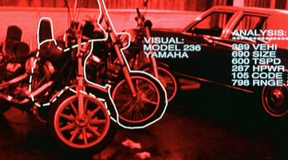
Wearable Games (AR)
"Valve's 'Terminator Vision' concept sees computer generated overlays added directly over your field of view in order to create a revolutionary new approach to gaming.“
http://www.gamesindustry.biz/articles/digitalfoundry-in-theory-valves-wearable-computing-concept

Slide 12
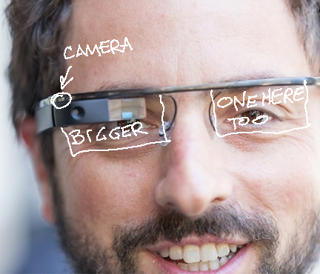
Game platform of the “future”
A mobile AR device – not a VR device tethered to a PC
A see-through HUD or HMD
But even more than that...
Image: venturebeat.com
(modified)

Slide 13
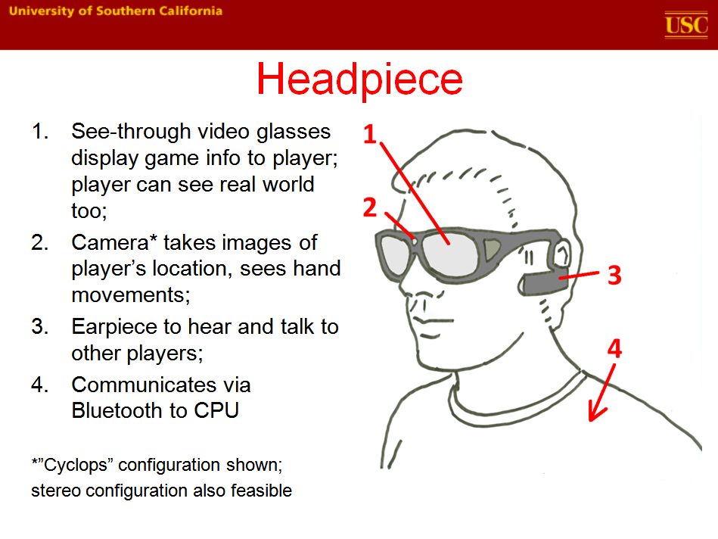

Slide 14
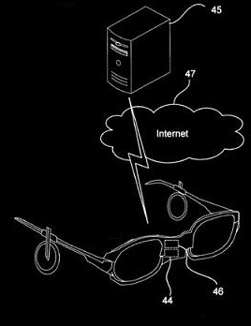
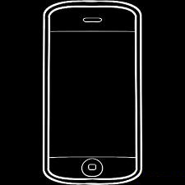
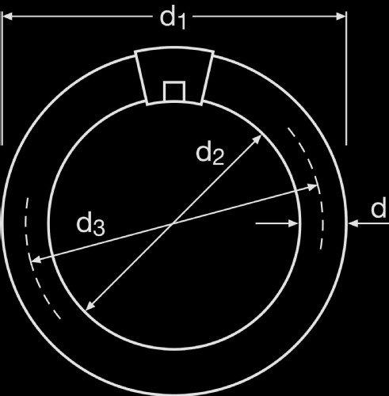
The cloud
The headset is just a display and receiver/transmitter, not a game machine per se
The game logic, collision detection, scoring, and all user inputs are calculated on a server in the cloud
Cloud connection: smartphone

Slide 15
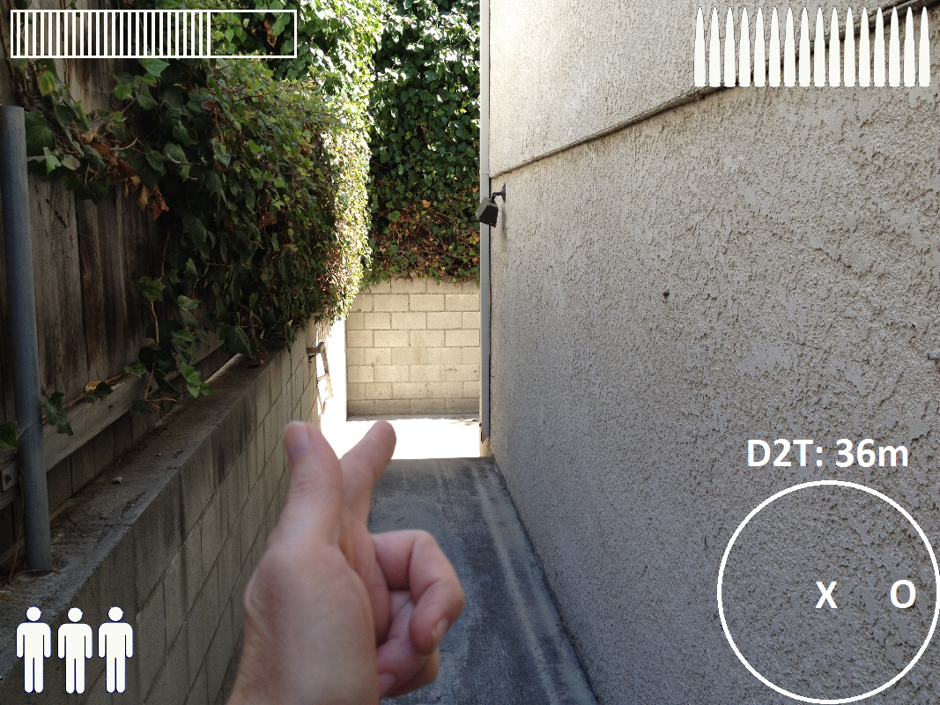
Alien Beast FPS

Slide 16
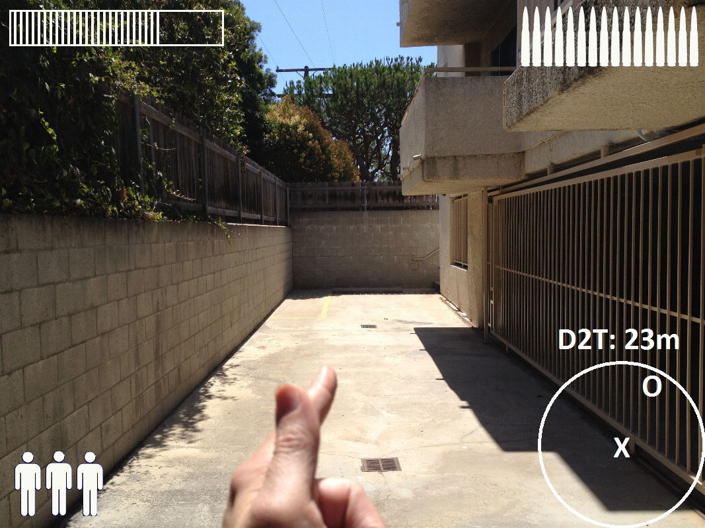
Alien Beast FPS

Slide 17
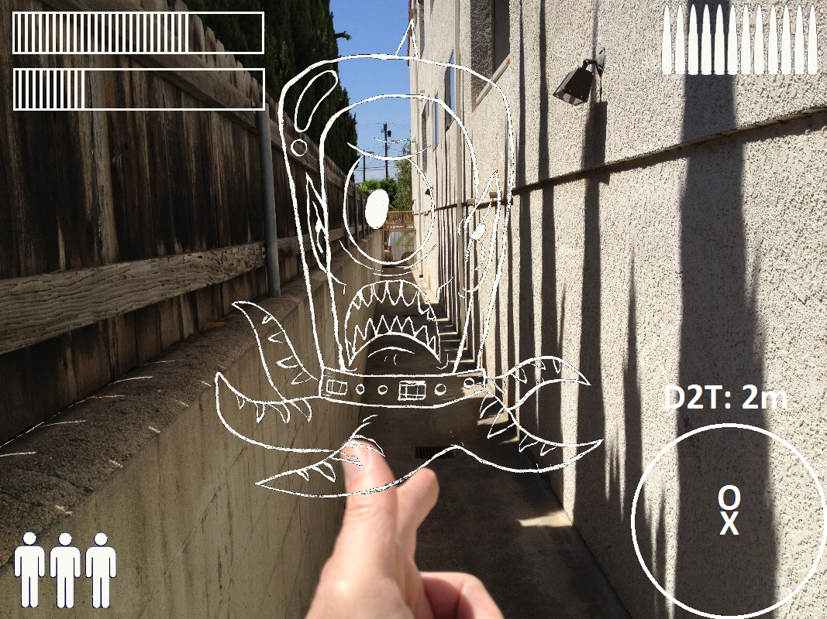
Alien Beast FPS

Slide 18

Unforeseeable consequences
You thought texting while walking was bad??
There will be laws!

Slide 19



How do you...
...warn players about real-world dangers? Cliffs, tall buildings, lions, tigers, bears
...make sure players don’t play in traffic?
...keep game from being played where games not appropriate? Airports, schools, malls, libraries, cemeteries, religious centers

Slide 20


Slide 21
HTE’s “IR Goggles” Idea
Naturally, I was interested
We met the doctors
Gathered list of requirements
Went online, did research (November-December)

Slide 22

The need

Slide 23
Features
Required
Desired
Streaming video (15fps or better)
Transparent
Lead shielded
Wearable with glasses
Voice command
Eye tracking
Binocular
3D
Lightweight

Slide 24
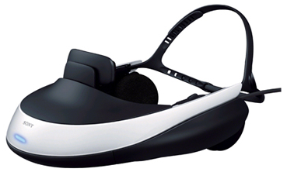
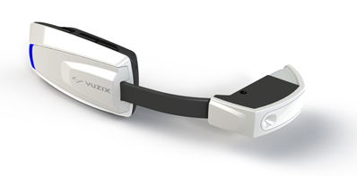
Variety of wearable computers
Google Glass
Sony HMZ-T1
Oculus Rift
Epson Moverio BT-100
Vuzix M100
Microsoft
CastAR
Oakley Airwave
Zeal Optics Transcend

Slide 25
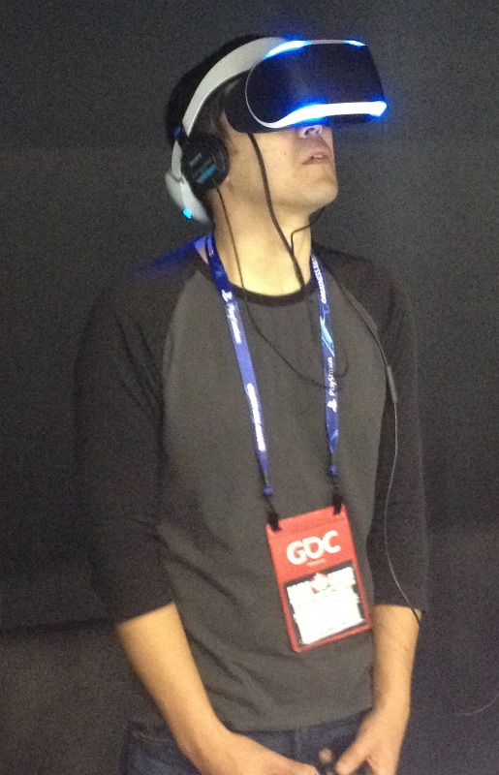
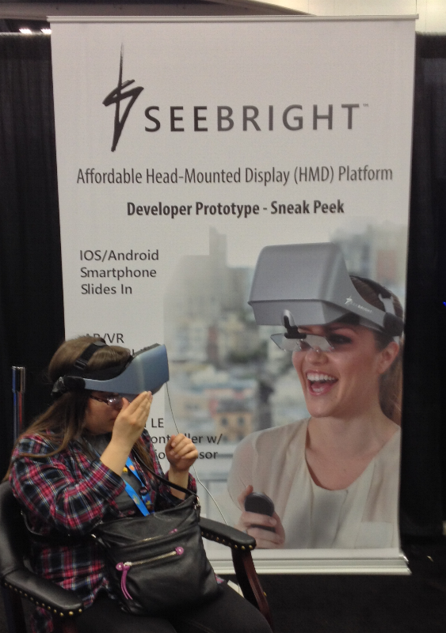
Last week at GDC
Sony’s MORPHEUS
SEEBRIGHT

Slide 26
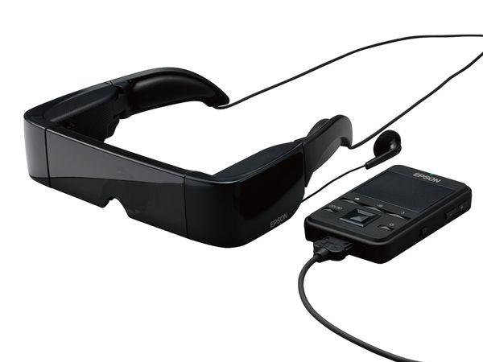
Epson’s Moverio BT-100
Pros:
Supports streaming video via Wi-Fi
Transparent (can see real world through display)
Fits over glasses
Binocular
Free SDK
Epson’s US office is in Long Beach
Cons:
No voice-control at present
Heavy
Limited availability

Slide 27

Seeing Is Believing
After Christmas break and CES were out of the way, we got to see the BT-200 in person
Yes, I said 200 (not 100)
Newer, lighter, even better for our needs
Pronounced highly suitable

Slide 28
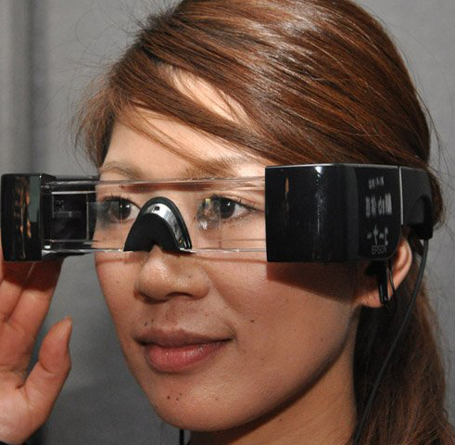
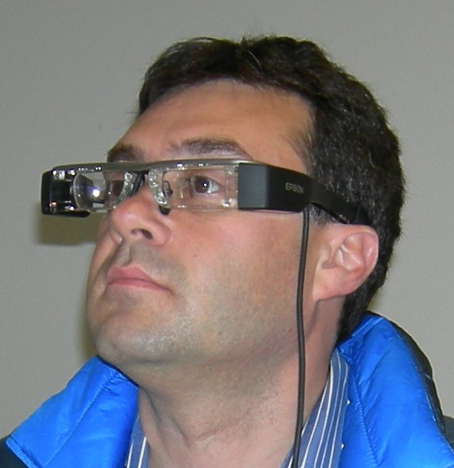
The old – the new
BT-100
BT-200

Slide 29


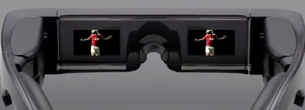
Still to do
Pass requirements
IT
Health
Siemens
Lead shielding
Stream some video
Test under safe conditions

Slide 30
Thanks for listening
Tom Sloper
sloper@usc.edu
http://itp.usc.edu/faculty-staff/Tom-Sloper
These slides: http://sloperama.com/downlode/
Michael Crowley
crowley@vsoe.usc.edu
http://itp.usc.edu/faculty-staff/Michael-Crowley/

Slide 31
In case anyone’s interested
Google Glass: Can’t display streaming video
Sony HMZ-T1: VR, not AR; cannot see real world
Oculus Rift: VR, not AR; not wireless, can’t see
Epson Moverio BT-100
Vuzix M100; supports Bluetooth only (no video)
Microsoft; rumors only, no information available
CastAR; Kickstarter; no information available
Oakley Airwave; designed for skiers, athletes
Zeal Optics Transcend; ditto

