Slide 1
The Future of Video Games
Tom Sloper
Game designer, producer
Platforms: Atari 2600, 7800, Vectrex → Xbox 360, IPTV
Experience: Sega, Atari, Activision, Yahoo
Faculty, video games
University of Southern California, Viterbi School of Engineering, Information Technology Program
Future Salon LA
Microsoft Store
Westfield Century City
August 12, 2012

Slide 2

Outline
The future is built on the past
Hardware (platforms)
Software (game genres)
The player
Who
Where
The business
Development
Publishing
The platform of the future

Slide 3
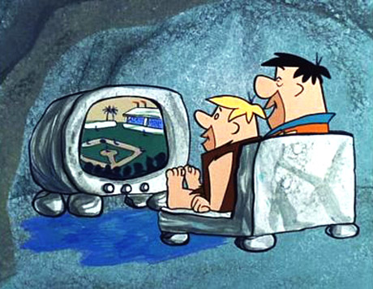
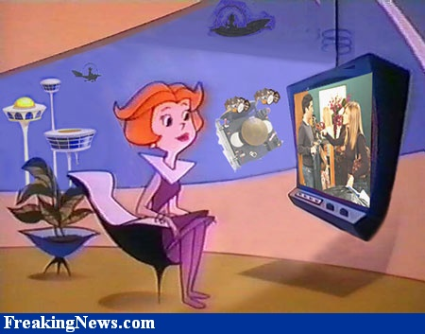
The Future Is Built On The Past
doomsteaddiner.org FreakingNews.com

Slide 4
In the home: On the shoulders of silicon-and-plastic giants
8-bit generations 1972-1990
Odyssey, Pong, Channel F
Atari 2600, 5200, Odyssey², Intellivision, Colecovision, Vectrex
Atari 7800, NES, Master System
Fourth generation (16-bit)
TurboGrafx-16, 1987
Genesis, 1989 (US)
Neo-Geo, 1990
SNES, 1991 (US)
Fifth generation
Jaguar, 1993
3DO, 1993
Saturn, 1994
PlayStation, 1994
Nintendo 64, 1996
Sixth Generation
DreamCast, 1999
PlayStation2, 2000
Xbox, 2001
GameCube, 2001
Seventh generation
Xbox 360, 2005
Wii, 2006
PlayStation3, 2006 (US)
Eighth generation
Wii U 2012
PlayStation 4, codename “Orbis”
Xbox 720, codename “Durango”
Ouya

Slide 5
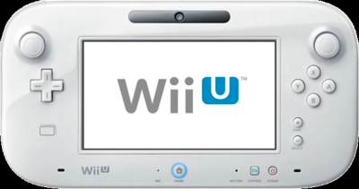
Wii U GamePad
Weapon aim, firing control (Legend of Zelda: BattleQuest, Nintendo Land: Takamaru’s Castle)
Pinball control (Nintendo Land: Donkey Kong’s Crash Course)
Flashlight control (Nintendo Land: Luigi’s Ghost Mansion)
Personal POV map view (Zombi U, Pikmin 3, Batman Arkham City: Armored Edition)
1st person POV (on TV: 3rd-person POV splitscreen) (Nintendo Land: Animal Crossing: Sweet Day, Tank Tank Tank)
Game/character stats (Ninja Gaiden 3: Razor’s Edge)
Touchscreen control (Rayman Legends, Trine 2, Scribblenauts Unlimited, New Super Mario Brothers U, Batman Arkham City: Armored Edition)
Can work in tandem with Wii Remote

Slide 6

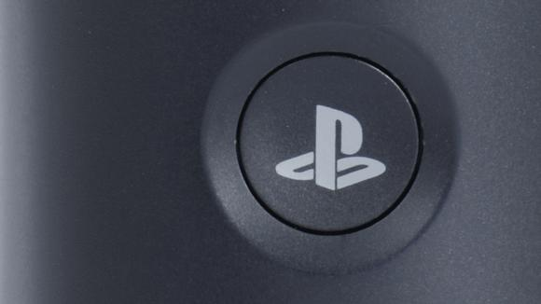
Rumor has it...
Xbox 720
Xmas 2013.
To include Blu-ray and DVR functionality.
2nd-gen Kinect included.
2nd-hand game sales to be prevented somehow.
Code name “Durango,” may be released as “Xbox Infinity” (clue: xbox8.com).
Images: techradar.com
PlayStation 4
Xmas 2013.
Expect stronger Vita linkage, maybe Android/Google tie-in, maybe with ads.
2nd-hand games lockout.
Not backward compatible.
Expect a Gaikai tie-in.
May be released as “Orbis” (“Orbis Vitae” = “Circle of Life”).

Slide 7
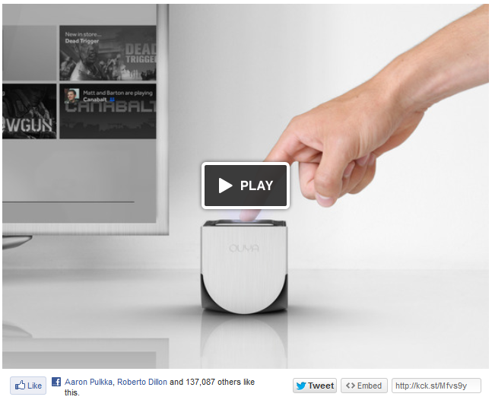

Ouya
Crowdfunded console for the TV (Kickstarter)
Android OS
The console is in the controller (the controller is the console)
Streams OnLive, Vevo, TuneIn, iHeartRadio
Low console price
Games free to try
Open games: no licensing, retail, or publishing fees

Slide 8

Indian Summer for Consoles?
Will the coming Big Three game console generation be the last?
Image: Wikipedia

Slide 9

Consoles’ Last Gasp (Yawn)?
“I can't recall a time when there's been less general enthusiasm for the arrival of the next generation of console hardware.” – Johnny Minkley, gamesindustry.biz, 8/7/12
"Console is not dead“ – David Cole, gamesindustry.biz, 6/21/12
Photographicdictionary.com

Slide 10

Outside the Home
Games people can’t play at home, or that they seek out as a special experience
Stand-up arcade games
Pong, Tank II, Asteroids
Sit-in arcade games
Outrun, Afterburner
Dance games
Multi-player racers, shooters
Image: http://jtmgames.com

Slide 11
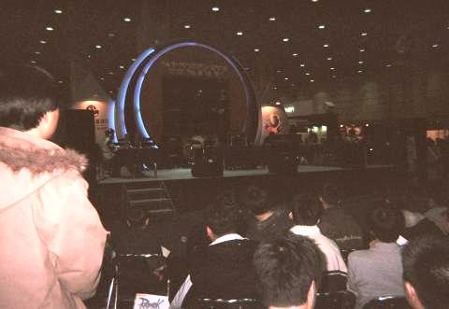
Location-Based Games
Cave Automatic Virtual Environment (CAVE)
BattleTech Centers
Laser Gun Game Centers
timeplay, IMAX, domes
Spectator eSports
Will continue to coexist with consumer games

Slide 12
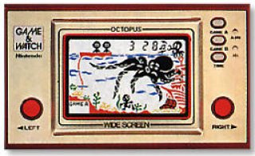
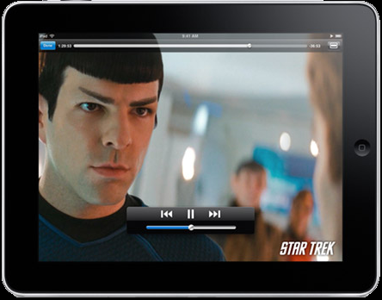
Handheld Timeline
Nintendo Game & Watch, 1980
GCE Game Time, Space Time, Sports Time 1982
GCE Chase-n-Counter, Space-n-Counter 1982
Game Boy, 1989
Atari Lynx, 1989
Sega Game Gear, 1990
Bandai Tamagotchi, 1996
N-Gage, 2003
Sony PSP, 2004
Nintendo DS, 2004
Gizmondo, 2005
iPhone, 2007
Android OS, 2007
Nintendo DSi, 2009
iPad, 2010
Nintendo 3DS, 2010
PlayStation Vita, 2011
BlackBerry PlayBook, 2011

Slide 13
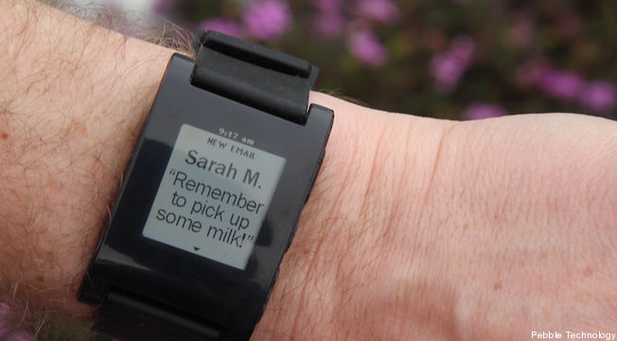
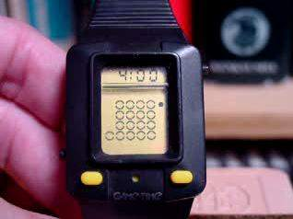

Wrist-Wearable Games
GCE Game Time, Arcade Time, Sports Time (1982)
Pebble e-paper watch (inPulse)

Slide 14
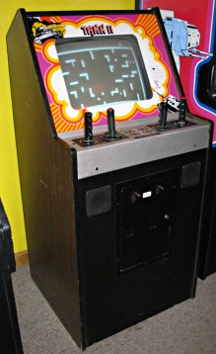
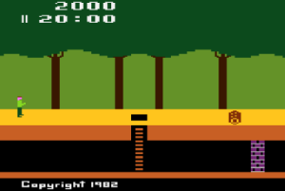


Genre Timeline
2-player (Pong, Tank II)
1-player (Pac-Man, Donkey Kong, Asteroids, Pitfall, Myst)
Multi-player online (Doom, Quake, World of Warcraft, Starcraft, Heroes of Newerth)
Social (Farmville, Cityville, Castleville, Words With Friends)
Serious (Air Medic Sky One, RoboMath)
classicarcademuseum.org, atariage.com, mmoreviews.com, blog.games.com

Slide 15
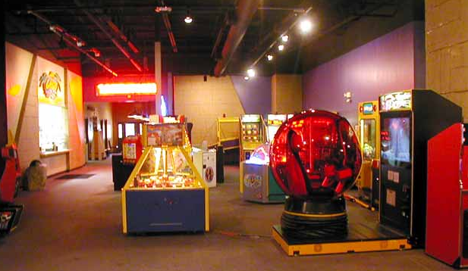
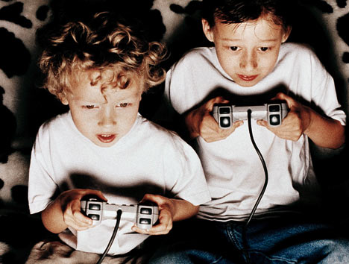
The player
Who is the player?
Traditionally: young and male
Ideally: everyone
Where is the player?
At home?
In the office?
Out and about?
In a special game venue?
Images: almightydad.com, the-lostcity.com

Slide 16



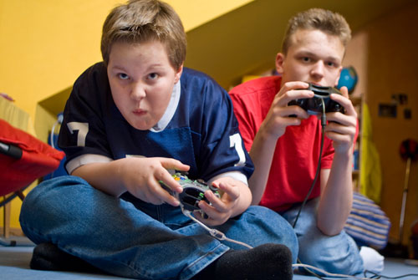
Who is the player? The Player: Past
Bartle types
Explorer
Killer
Socializer
Achiever
Hardcore
Casual
Tim Jeal / Faber, arbroath.blogspot.com
Unknown, 3.bp.blogspot.com

Slide 17


Who is the player? The Player: Present
Audience segmentation
The 1-minute gamer
The addicted every-waking-moment gamer
The $1 gamer (“minnows”)
The $60 gamer (“whales”)
The gamer on the go
The couch gamer
The gamer couple
...Still not “everyone”

Slide 18

Games tailored to you
Each segment needs different content, monetization, screen size, UI...
Expect further segmentation – refined definition of segments
We eat your cookies
Tailored to your location
Tailored to your recent activities
Tailored to your likes
Tailored to your dislikes
Image: tustinmagazine.com

Slide 19

The Business
Development timeline
Early 1980s: 1 man
Late 1980s: small team of specialists
AAA: teams of specialist teams
Mobile: 1 man, or small team of specialists
Social: multiple teams (pods), cyclic process
Global distributed teams
Crowdfunding
Publishing timeline
A floppy in a baggie at the flea market
Publishing companies
Retail shows: CES, E3
Online distribution: Steam, XBLA, iStore, GoogleStore
Social networks: Facebook
The cloud
Image: tvgarth.blogspot.com

Slide 20

Trending Business Models
Parallels, sort of:
Movies, TV (world of freelancers)
Music publishing
Book publishing
Retail products → online service
Crowdsourced development
Crowdsourced platforms
Consoles still #1, short-term (Magid Associates survey)
DLC
Multi-platform play
Tablets

Slide 21


The Future of Games – GDC 2010
“The Three Pillars of Growth”
Motion control
Online, social
3D

Slide 22

The Future of Games
But are those really the correct Pillars??
How about...
Photo-realism
4D
Touch screen
Interoperability, 2nd screen
Wearable games, Virtual Reality, Augmented Reality

Slide 23

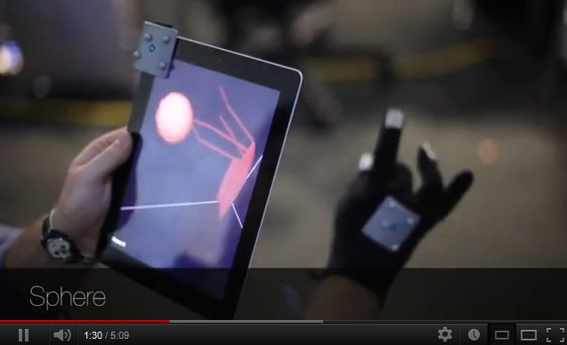
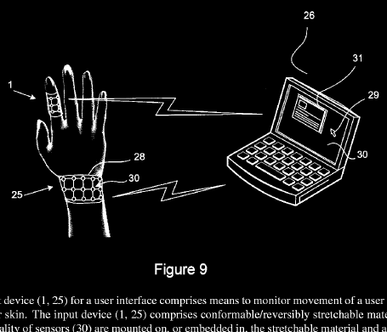
Motion control timeline
Mattel Power Glove, 1989
PlayStation Sixaxis
Wii Remote (“Wiimote”)
iPhone
Nokia 2009 patent filing
Xbox Kinect
PlayStation Move
Wii U remote
MIT iPad glove

Slide 24


Online, Social
Games as product
Online distribution – will it replace retail?
DLC
Going beyond Facebook
Sharing, invites
Elusive mainstream mass market
Zynga trouble
Social disconnect
Games as service...

Slide 25
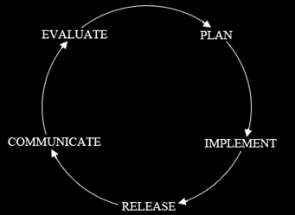
Games as service
A social game is a service, not a product
It’s never finished
It’s constantly being upgraded
“Metrics, metrics, metrics”
Multiple teams (“pods”) always working
Each pod is at a different point in the cycle
Pod 1
Pod 2
Pod 3
Executive Producer & Design Director

Slide 26

The cloud
Player doesn’t need dedicated hardware to play; the game is played on servers—video and audio are streamed to the user
On June 15, Sony said “It’s absolutely inevitable” that the cloud is “going to be a part of what everyone does.”
Sony purchased Gaikai two weeks later for $380M
OnLive (Ouya)

Slide 27

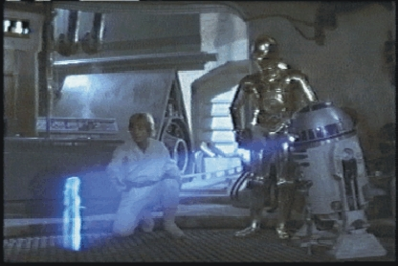
3D
Vectrex 3D glasses, 1983
Nintendo Virtual Boy, 3DS
Xbox 720 to incorporate 3D
3D will likely always require special equipment
Glasses
3D display
Consider the hologram
Ghostly “uncanny valley”
Narrow field of view
Image: Lucasfilm

Slide 28


Photo-realism & Emotion
The Holy Grail: photo-realism (“indistinguishable from reality”)
Heightens immersion
Increases emotional connection
Needs actors, directors from film world
Problem: story on rails
Home.messiah.edu, Fanpop.com

Slide 29


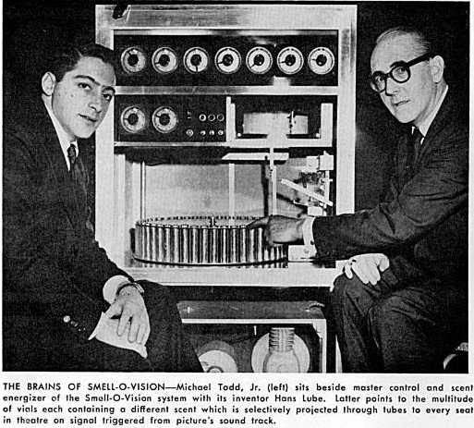
4D
3D movie with physical effects in the theater
Smell-o-vision
Rain, mist, snow
Wind
Vibration
“The Tingler”
Games and movies watch each other
How to do this in the home? – probably won’t
crda.org, collectiondx.com, wired.com

Slide 30
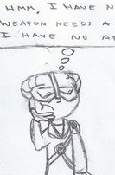
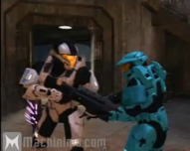
User-generated content?
The problem:
Game can’t create assets on the fly
That’s why endings are predetermined
True interactivity (e.g. Star Trek holodeck): not in the near future
User-created mods take time and know-how; challenging to propagate widely
Machinima
Commentators in spectator eSports competitions (online or in a location)
Th08.deviantart.net Austinsaysno

Slide 31

Touch screen
Smartphones
Tablets
Kiosks, ATMs
Seems like we’re still living in Flintstones land, but screen must be within physical reach
Whenever a screen is expected to be within easy reach, it will inevitably/eventually be touch-sensitive – computer monitors yes, TVs no
Image: staymedia.ch

Slide 32
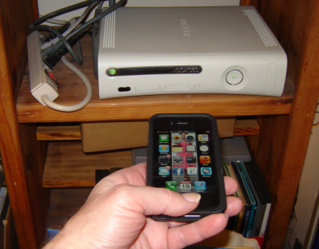
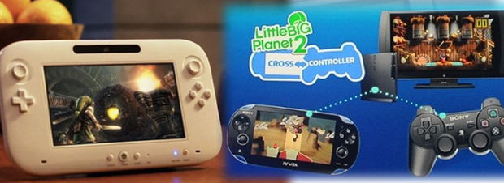
Interoperability
Cross-platform interoperability?
iPhone-Xbox
3DS-PS3
Unlikely; requires platform holder support
Platform holder interoperability, though...
2nd-screen controllers
PS3, Vita
Wii U GamePad
Xbox SmartGlass
Image: destructoid.com

Slide 33

The Platform of the Future

Slide 34
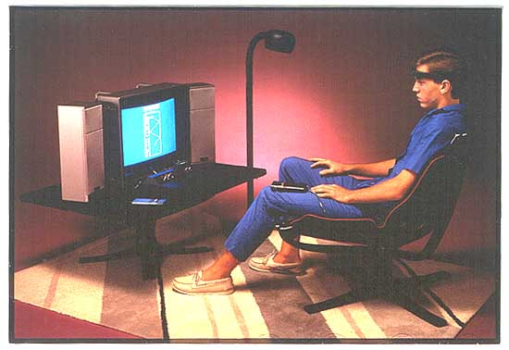
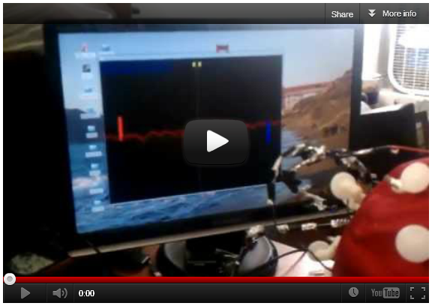
Brain Waves??
Atari Mindlink, 1984 (image: atarimuseum.com)
Cornell students, 2012 (image: slate.com)
“Accessibility, accessibility, accessibility”

Slide 35
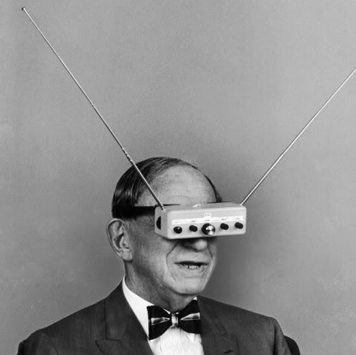
Augmented Reality (AR)
Wearable television was foreseen quite some time back
Image: tsutpen.blogspot.com

Slide 36
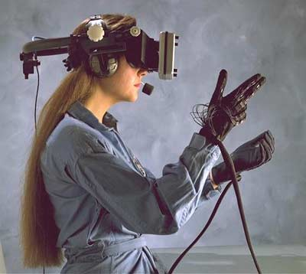
Virtual Reality
VR headsets and gloves
“Disclosure” (1994)
“Minority Report” (2002)
“Cybersickness, cybersickness, cyber-sickness”
Image: electronics.howstuffworks.com

Slide 37

John Carmack’s vision
“’Not all that excited’ by coming game hardware [nor by 3D]...
...Does see a bright future with VR headsets though”
Doom 3 BFG Edition
Palmer Luckey: Oculus Rift, Kickstarter
“It won’t sweep the world in a year or two” and “it takes a whole ecosystem though” (gamesindustry.biz, 6/19/12)

Slide 38
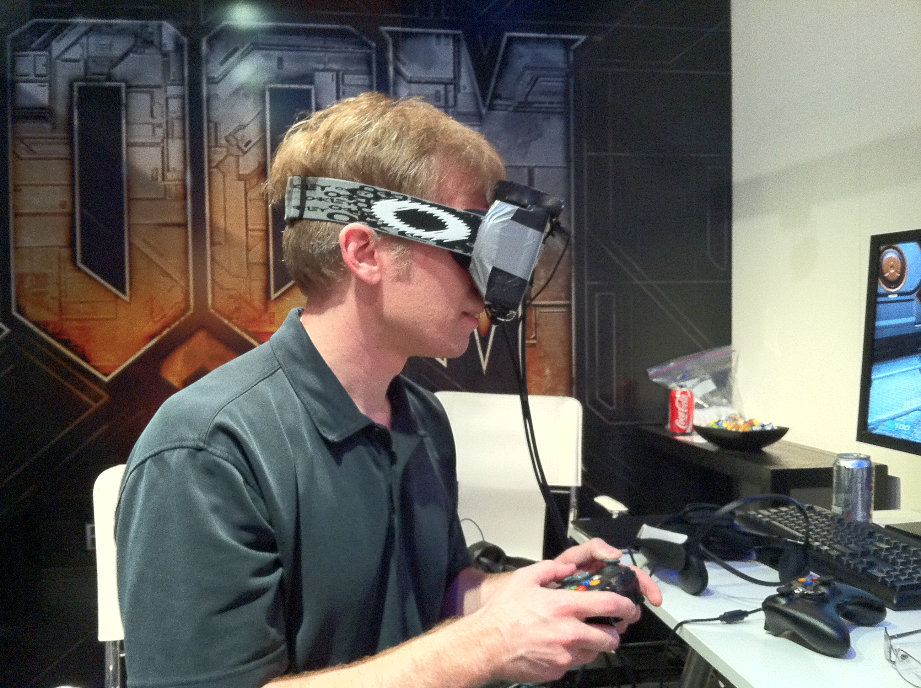
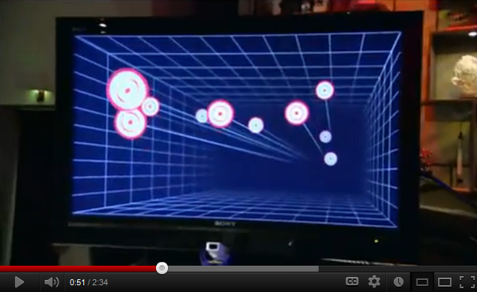
Oculus Rift
L: Carmack at E3 2012
R: What Head Tracking looks like (youtube)
A nifty 3D viewer for your PC game
Images: gamesindustry.biz, youtube.com

Slide 39
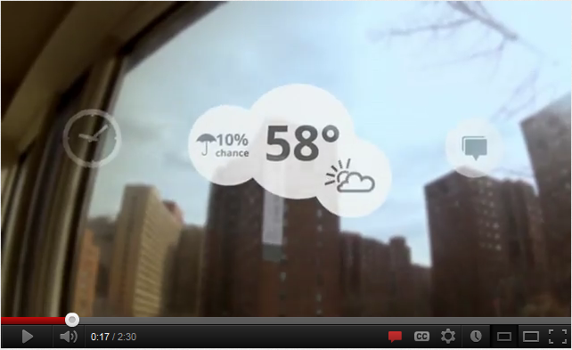
Wearable Computers
“Project Glass is a research and development program by Google to prototype and build an augmented reality head-mounted display (or HMD).” http://en.wikipedia.org/wiki/Project_Glass
http://www.youtube.com/watch?v=9c6W4CCU9M4
“Project Glass: One Day...”

Slide 40
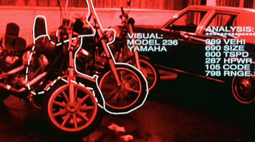
Wearable Games
"Valve's 'Terminator Vision' concept sees computer generated overlays added directly over your field of view in order to create a revolutionary new approach to gaming.“
http://www.gamesindustry.biz/articles/digitalfoundry-in-theory-valves-wearable-computing-concept

Slide 41
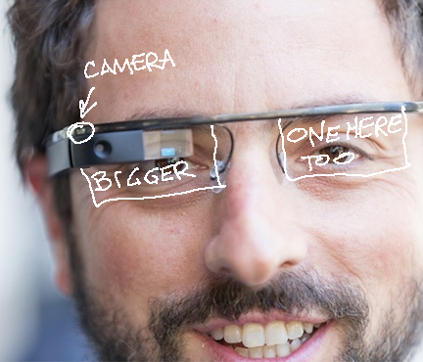
A mobile AR device – not a VR device tethered to a PC
A see-through HUD or HMD
But even more than that...
Image: venturebeat.com
(modified)

Slide 42


Slide 43
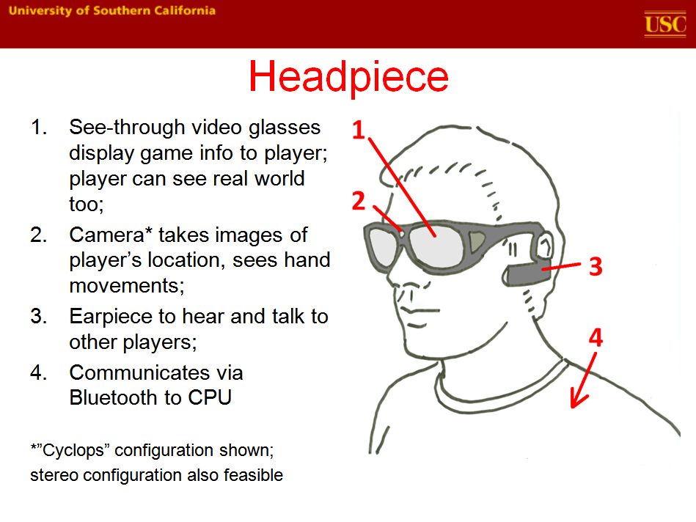

Slide 44
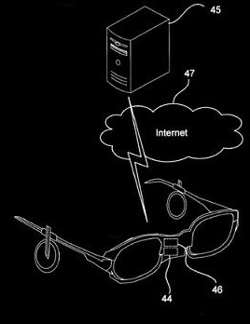

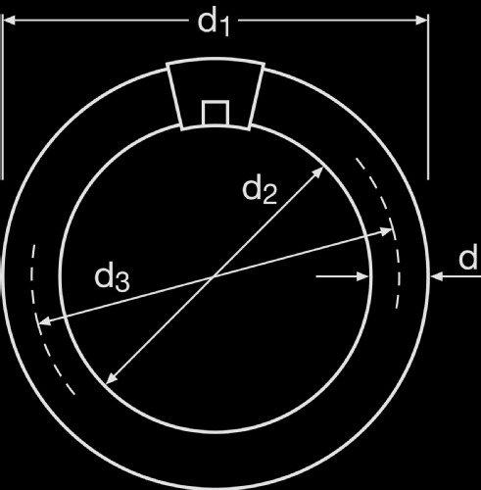
The cloud
The headset is just a display and receiver/transmitter, not a game machine per se
The game logic, collision detection, scoring, and all user inputs are calculated on a server in the cloud
Cloud connection: smartphone

Slide 45

GPS
Multi-player shooter – GPS knows location of your opponents (alien monsters, for example), in relation to your real world location
HUD can overlay alien monster image (for example) over the visible actual opponent
Can also show you an A.I. alien monster where no actual person exists
Image: Defenseindustrydaily.com

Slide 46

Wearable camera
Can see what the player sees
Can see player’s hand movements (when hand in camera’s field of view)
Can upload player’s view to the game in the cloud
Can give spectators, commentators, opponents a view of the game from player’s POV
http://andrewsullivan.thedailybeast.com/2012/06/the-future-of-seeing.html

Slide 47
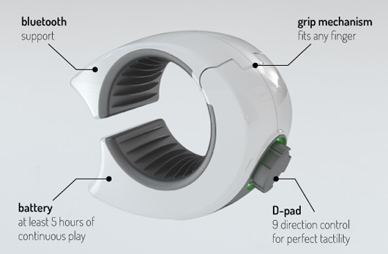
Bluetooth ring
Ring can include several micro sensors (e.g. accelerometer, gyroscope, magnetometer...)
Better input than can be obtained by camera view of hand
In the works: Swedish university, Ringbow (pictured)

Slide 48

No recycling this time
When mobile games came on the scene, game designers harkened back to the simplicity of 2600 and LCD games
But with AR glasses? Whole new ball game!
A whole new ball game

Slide 49
What kind of games can be played on it?
First-person shooters – multi-player or single
Drawback: death by cop
Scavenger hunts, treasure hunts, dungeon crawls
Drawback: arrest for trespassing
Map conquest à la Risk
Drawback: actual global conquest
Parkour planning
Drawback: ambulance/hospital/funeral bills
Sliding block puzzles; draw pictures in the air; draw pictures on the Earth
Drawback: look like a dork (so what else is new?)

Slide 50
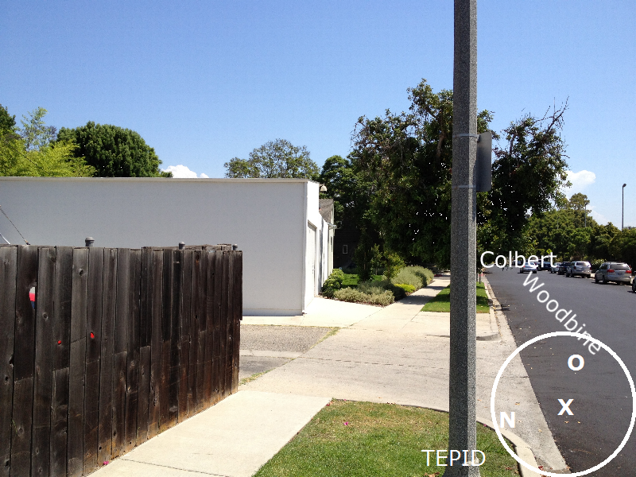
Treasure Hunt

Slide 51
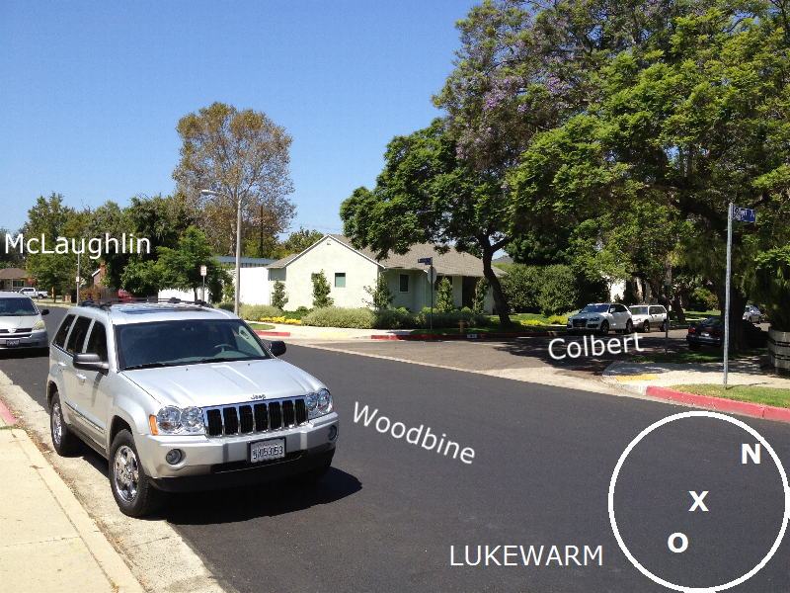
Treasure Hunt

Slide 52
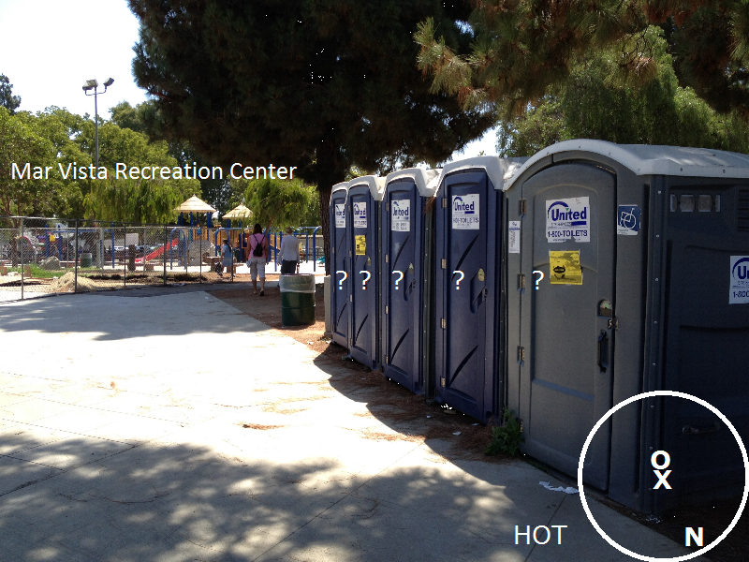
Treasure Hunt

Slide 53
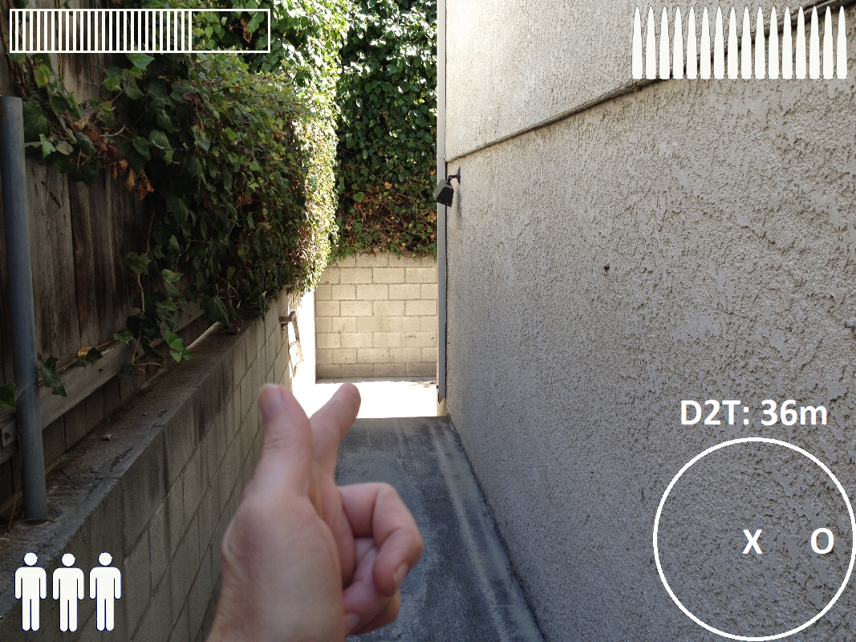
Alien Beast FPS

Slide 54
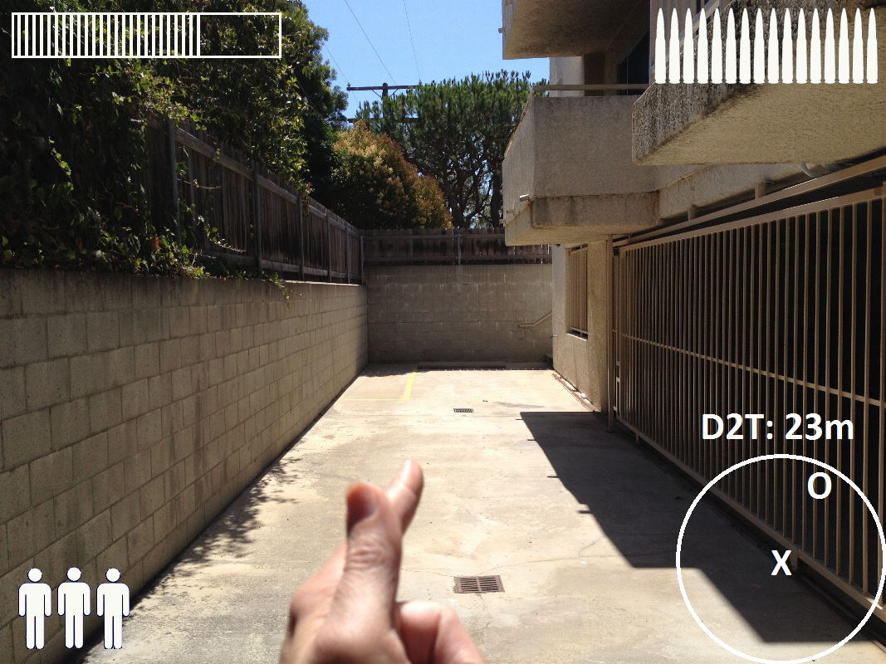
Alien Beast FPS

Slide 55
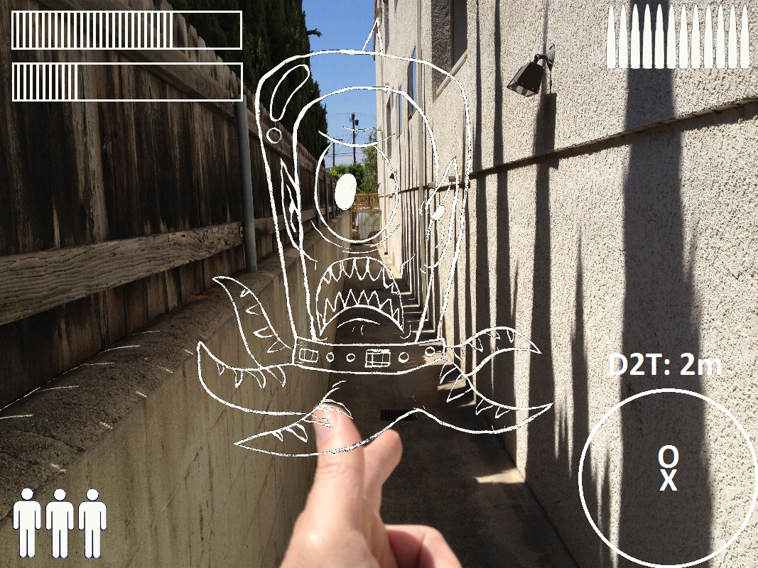
Alien Beast FPS

Slide 56

Unforeseeable consequences
You thought texting while walking was bad??
There will be laws!

Slide 57



How do you...
...warn players about real-world dangers? Cliffs, tall buildings, lions, tigers, bears
...make sure players don’t play in traffic?
...keep game from being played where games not appropriate? Airports, schools, malls, libraries, cemeteries, religious centers

Slide 58
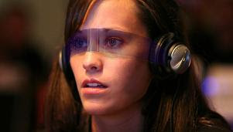
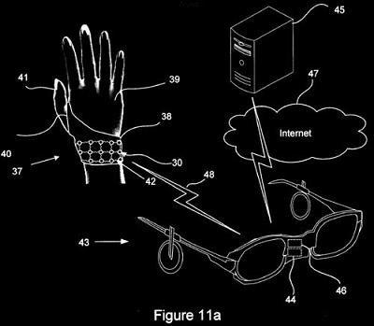
Is this it?
Will this be the hotness of the next decade?
Of course I have no idea! Nobody can predict the future. “He who believes he can predict is least likely to predict correctly” – Taleb, “The Black Swan”
What will be hot depends on who the player is,
How s/he wants to play,
And where.
Images: theclevermonkey.blogspot.com

Slide 59

“This is it.
This is the seminal point. Where there’s a reasonable chance that out of this will explode all the wearable gaming stuff we've been treating as science fiction for so many years." - Michael Abrash, Valve (Virtual Insanity, QuakeCon 2012 panel) http://youtu.be/8gaqQdyfAz8?hd=1

Slide 60

Let’s wrap it up
Coexisting platforms – TV, desktop, tablet, smartphone, location-based, wearable – Every possible screen size
Coexisting genres
Coexisting player types – but: “everyone”???
Coexisting business models
Image: girlinterruptedeating.wordpress.com

Slide 61


Just imagine
The ultimate immersion game:
Players riding a roller-coaster, inside a projection dome
Seats equipped with smell-o-vision and tinglers
TV monitor in front of each player
Holding a tablet controller
While wearing AR glasses and glove
Of course, don’t forget Brain Waves...
Sensory overload, anyone?
Whatever happened to simple?

Slide 62
Thanks for listening! Questions?
Tom Sloper
Academic: sloper@usc.edu
Business: Tom@Sloperama.com
These slides: http://sloperama.com/downlode/

