Slide 1

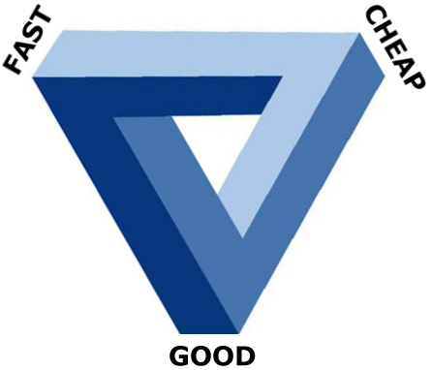

The Evil Triangle A Constantly Rotating Target
Tom Sloper 탐 슬로퍼

Slide 2
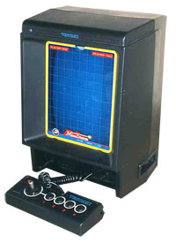
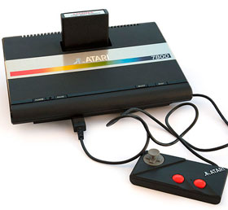
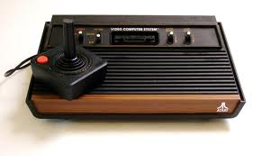
Background
Started in design before becoming a producer
Atari Corp. – Director of Product Development, 1986-87
Responsible for 35 external projects
Expected to start up 35 more
Impossible for one person – released 20 SKUs
“Cheap” and “fast” were everything at Atari Corp.
“Good” never came up
Learned how to get things done

Slide 3
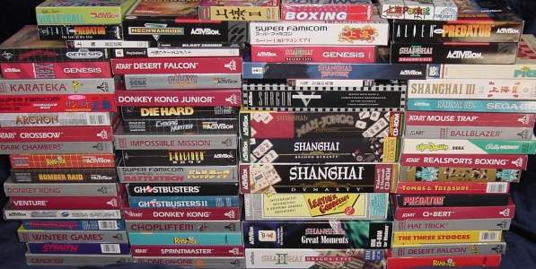
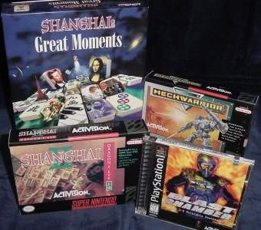
Activision, 1988-2000
Worked on 120 external projects
And 20 internal projects
My reputation, 1988-1989: “a hell of an executor”
Japan, 1990
My rep, post-1991: “the Shanghai guru”
Trained 6 up-and-coming producers
5 awards

Slide 4




More Recently
Mastiff Games, 2005
Top Gun for Nintendo DS
Yahoo! Games, 2006
5 games for IPTV (uVerse)
Naked Sky Entertainment, 2009
Star Trek D·A·C for XBLA
University of Southern California (USC) – http://www.itp.usc.edu
Designing & Producing Video Games
Video Game Quality Assurance
Game Startups Workshop

Slide 5
The Evil Triangle
Also called “The Impossible Triangle”

Slide 6
The Evil Triangle
The classic wisdom holds that a project cannot be cheap and fast and good; that it can only achieve two of the three.
Whether or not you believe in the Evil Triangle, you have to constantly monitor the project, and reassess your progress, so that you know where to put the most focus for the next sprint.

Slide 7
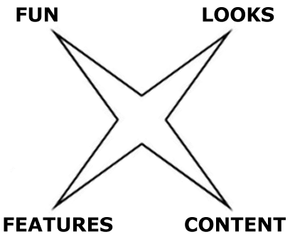
The Evil Triangle
And even if you do believe that you can have only two points of the triangle, you never have to entirely give up on the third.
A key to achieving maximum results is to remember that "good" is a multi-pointed shape in its own right.

Slide 8

Let’s define terms
"Fast" – Time (within planned schedule)
"Cheap" – Cost (within planned budget)
"Good" – Much more complicated to define (so we’ll start there)
"Stakeholders“ – party with vested interest
Primary: publisher, IP owner, platform holder (and developer, if developer owns IP)
Secondary: developer, retailer, end user

Slide 9
QUALITY (“Good”)
Time and money are easily quantified; but “quality” is subjective.
Different people have different ideas of quality.
Quality – the “good” corner of the triangle – has multiple corners of its own. Quality can rightly be considered to consist of:
Looks (visual quality, audio quality)
Functionality (features, usability) (and no bugs)
Length / depth / complexity (levels, world size, options, story – in other words: content)
Fun

Slide 10
Q1: LOOKS
What affects visual & audio quality
Talent and experience can reliably produce visual/audio quality
Time can produce quality; rushed work looks rushed
What visual quality affects in a project
Should not cause a significant delay
Can add to cost, but usually the major cost is in the programming
Cutting visual quality looks bad; no good reason to ever sacrifice here

Slide 11
Q2: FEATURES
What affects functionality/usability quality
Talent, imagination
Competitive drive (comparing to competitive products)
Time, and the drive to constantly improve (change requests; “feature creep”)
What functional quality affects in a project
Time (more features take more time to implement and test)
Cost (more personnel, more time mean higher cost)

Slide 12
Q3: LENGTH / DEPTH
What affects game length/depth: content
Levels, worlds, areas
Story, characters, missions/puzzles
What game length/depth affects in a project
Art/animation time and cost
Audio (voice-overs, sound effects) time and cost
Programming time and cost
Quality Assurance testing time and cost

Slide 13

Q4: FUN
THE MOST IMPORTANT QUALITY!
What affects fun
Talented design (can cost more)
Iterative design (takes more time)
Play testing (adds to time and cost)
What fun affects in a project
Effect on team morale
Effect on overall sales

Slide 14

Q4: FUN
But fun does not require more features, complexity, fancy animation, expensive voice acting talent
We often forget the value of simplicity
‘Tis a gift to be simple
Simplicity can be elegant; “less is more”
But there’s always intense pressure to add more (“feature creep”)

Slide 15
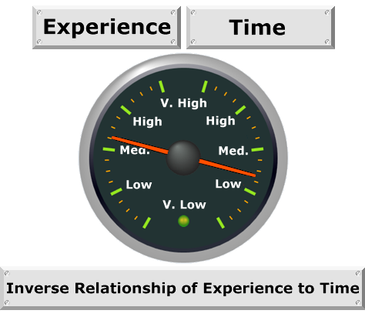
TIME
What affects time (man-hours)
Experience: inverse relationship with time
Experienced team
Experience with the technology
Experience with the genre
Experience with the platform
Experienced team management
Experienced project management
Experienced publisher management
Quality
Features, more so than assets
Change requests

Slide 16
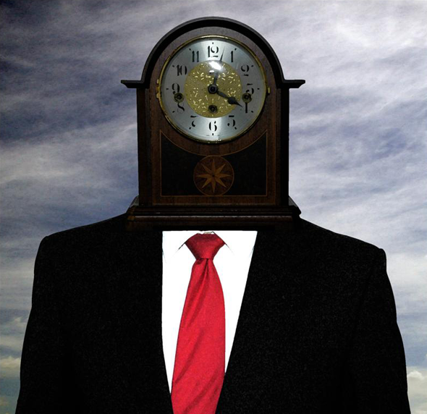
TIME
What more time affects
Quality. The more time, the better the product (up to a point) – the more polish
Cost. The more man-hours, the greater the cost
Features. When there is time: natural inclination to add features (“feature creep” danger)
Length / Depth. Time permits the creation of more content

Slide 17

COST
What affects cost
Time (man-hours)
Features cost money
Programming costs money
Testing costs money
Quality
Experienced talent costs money
Head count
Overhead costs
Head count quandary: the mythical man-month (MMM)

Slide 18
COST
What more money affects in a project
Quality. More money means higher quality
Experienced talent
And more asset creation time or talented personnel*
More money means you can have more features
More programming time (or head count – *subject to the MMM rule)
More testing time (or testers*)

Slide 19

PRIORITIZING the TRIANGLE
Rolling Stones: “You can’t always get what you want.”
If you truly can’t have all three, which two are most important (at the moment) for your stakeholders?
Unless it’s a triple-A game, most likely the schedule and budget cannot be lengthened; and they may even be shortened!
So “good” may have to give somewhere. But where?
Functionality (features, usability)?
Length / depth / complexity (levels, world size, options)?
Looks (visual quality)?
Fun?

Slide 20

“Fast”
When fast is paramount
Low-cost, and/or small-scale projects
Time-sensitive projects
Christmas releases
Movie IP release date
When speed is expendable: AAA games
Examples (next slides)
Top Gun DS
Star Trek D·A·C

Slide 21


Top Gun DS
Mastiff’s Head Woof, Bill Swartz, needed schedule shortened
Fun was not sacrificed
Visual quality was not sacrificed
Audio was done on the cheap, though

Slide 22

Star Trek D·A·C
Producer Ben Hoyt did not believe in the Evil Triangle
Did not sacrifice fun
Did not sacrifice visual quality
Two major features had to be cut, though

Slide 23

“Cheap”
When budget is paramount:
Market economics (low-price product)
XBLA
iPhone
Publisher unwilling/unable to spend
When money is no object: AAA games
Budget examples
Star Trek D·A·C
Yahoo! Games IPTV projects
Shanghai: Second Dynasty (overspent / market shift)

Slide 24

“Good”
When good is paramount: AAA games
When [some aspect of] quality is flexible
Usual cuts: features, length/complexity
Rare to sacrifice visual quality
Fun is never expendable
Example: when “good” is paramount
L.A. Noire (Team Biondi / Rockstar)
8 years, and at least $50M
Legal troubles; perpetual crunch; money probs; closure
Money and time do not guarantee happy ending

Slide 25
The upshot
Sometimes the bosses absolutely refuse to allot any more money (game must be "cheap"). Unless the game can’t be finished without spending more.
Often, the publisher has a crying need for the product to ship on time, or even before ("fast"). But we’ve all seen product dates slip.
And the stakeholders look bad if the game is not fun or is poor quality (it has to be "good").

Slide 26
The upshot
With a AAA game, there is no evil triangle problem. You can have a big budget and a long schedule, because the sharpest point of the triangle must be the game's quality.
But for the rest of us, the triangle usually is a problem... Or is it? It doesn’t have to be!
Since "good" encompasses features, content, fun, and looks, there's a lot of room for tradeoffs – without sacrificing much quality.

Slide 27
“Good” is Not a Triangle Point
“Good” is a 4-pointed star in its own right
So that’s where you can make your quality adjustments
Fun must never be sacrificed,
And looks should not be sacrificed.
But features can be reduced,
And content can be shortened.

Slide 28
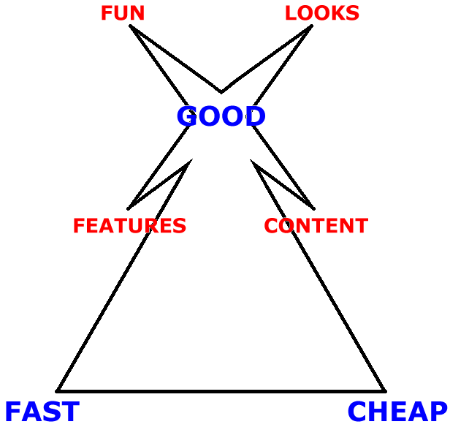
The upshot
The old saying isn’t true.
It isn’t even really a triangle.
It isn’t impossible.
And it isn’t evil.

Slide 29
Thanks for listening! Questions?
탐 슬로퍼
Tom Sloper
Sloperama Productions
tom@sloperama.com
1-310-344-7873
Los Angeles, CA, USA
www.sloperama.com/business.html

